Slide 1
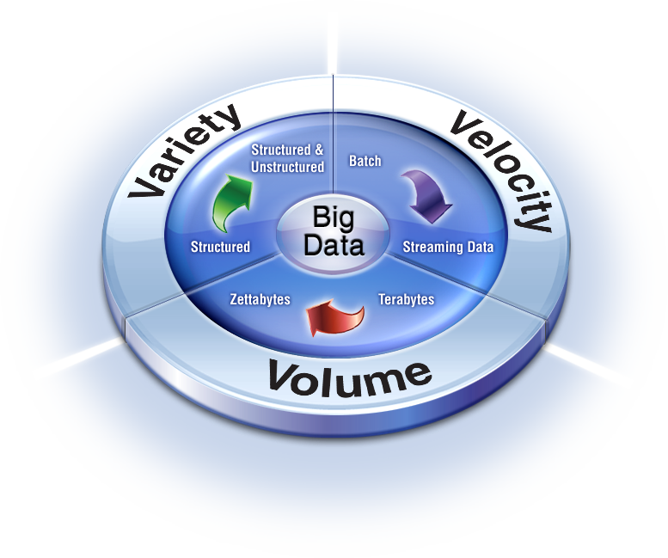
An overview of Big Data

Slide 2
Objective of today’s lecture
Understand what is meant by the term Big Data?
Understand why we need it
BIG DATA storage - NoSQL databases

Slide 3
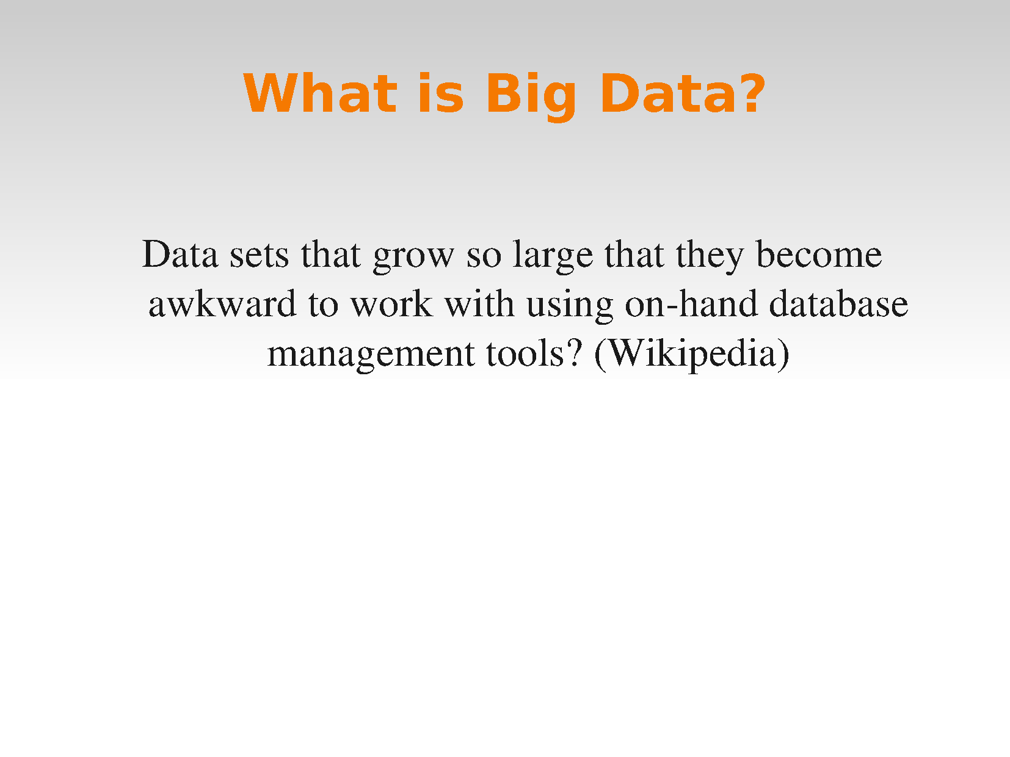

Slide 4
What is big data?
Data sets grow in size in part because they are increasingly being gathered by ubiquitous information-sensing mobile devices, aerial sensory technologies (remote sensing), software logs, cameras, microphones, radio-frequency identification (RFID) readers, and wireless sensor networks.^{[5][6][7]} The world's technological per-capita capacity to store information has roughly doubled every 40 months since the 1980s

Slide 5
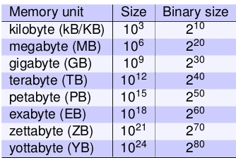
Simple to start
What is the maximum file size you have dealt so far?
Movies/Files/Streaming video that you have used?
What have you observed?
What is the maximum download speed you get?
Simple computation
How much time to just transfer.
250 trillion DVDs!!!

Slide 6
Huge amount of data
There are huge volumes of data in the world:
From the beginning of recorded time until 2003,
We created 5 billion gigabytes (exabytes) of data.
In 2011, the same amount was created every two days
In 2013, the same amount of data is created every 10 minutes.

Slide 7
Big data spans three dimensions: Volume, Velocity and Variety
Volume:
Turn 12 terabytes of Tweets created each day into improved product sentiment analysis
Convert 350 billion annual meter readings to better predict power consumption
Velocity:
Scrutinize 5 million trade events created each day to identify potential fraud
Analyze 500 million daily call detail records in real-time to predict customer churn faster
Variety:
Monitor 100’s of live video feeds from surveillance cameras to target points of interest
Exploit the 80% data growth in images, video and documents to improve customer satisfaction

Slide 8



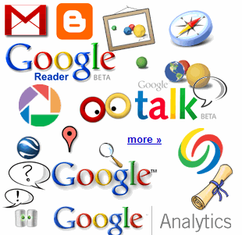

The Social Layer in an Instrumented Interconnected World
4.6 billion camera phones world wide
30 billion RFID tags today (1.3B in 2005)
12+ TBs of tweet data every day
100s of millions of GPS enabled devices sold annually
? TBs of data every day
2+ billion people on the Web by end 2011
25+ TBs of log data every day
76 million smart meters in 2009… 200M by 2014
Notes:
Obviously, there are many other forms of data. Let’s start with the hottest topic associated with Big Data today: social networks. Twitter generates about 12 terabytes a day of tweet data – which is every single day. Now, keep in mind, these numbers are hard to keep accurate, so the point is that they’re big, right? So don’t fixate on the actual number because they change all the time and realize that even if these numbers are out of date by 2 years, it’s at a point where it’s too staggering to handle exclusively using traditional approaches.
+CLICK+
Facebook over a year ago was generating 25 terabytes of log data every day (Facebook log data reference: http://www.datacenterknowledge.com/archives/2009/04/17/a-look-inside-facebooks-data-center/
) and probably about 7 to 8 terabytes of data that goes up on the Internet.
+CLICK+
Google, who knows? Look at Google Plus, YouTube, Google Maps, and all that kind of stuff. So that’s the left hand of this chart – the social network layer.
+CLICK+
Now let’s get back to instrumentation: there are massive amounts of proliferated technologies that allow us to be more interconnected than in the history of the world – and it just isn’t P2P (people to people) interconnections, it’s M2M (machine to machine) as well. Again, with these numbers, who cares what the current number is, I try to keep them updated, but it’s the point that even if they are out of date, it’s almost unimaginable how large these numbers are. Over 4.6 billion camera phones that leverage built-in GPD to tag your location or your photos, purpose built GPS devices, smart metres. If you recall the bridge that collapsed in Minneapolis a number of years ago in the USA, it was rebuilt with smart sensors inside it that measure the contraction of the concrete based on weather conditions, ice build up, and so much more.
So I didn’t realise how true it was when Sam P launched Smart Planet: I thought it was a marketing play. But truly the world is more instrumented, interconnected, and intelligent than it’s ever been before and this capability allows us to address new problems and gain new insight never before thought possible and that’s what the Big Data opportunity is going to be all about!
8

Slide 9
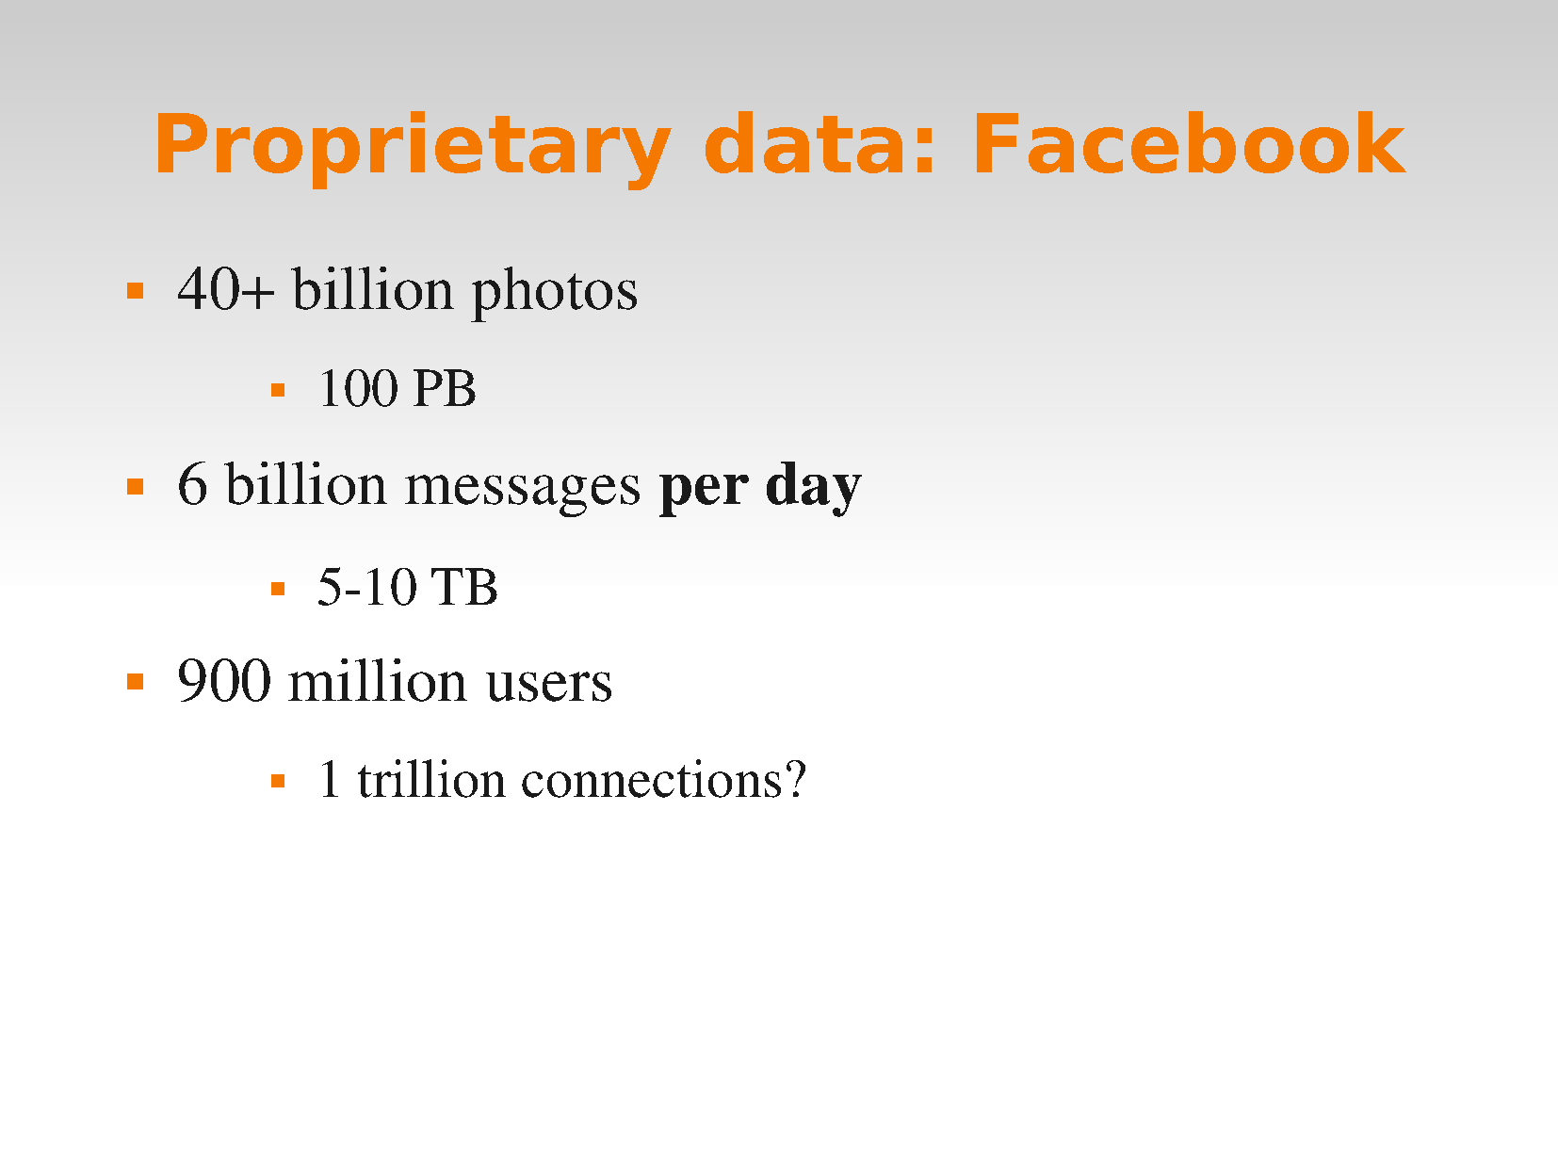

Slide 10
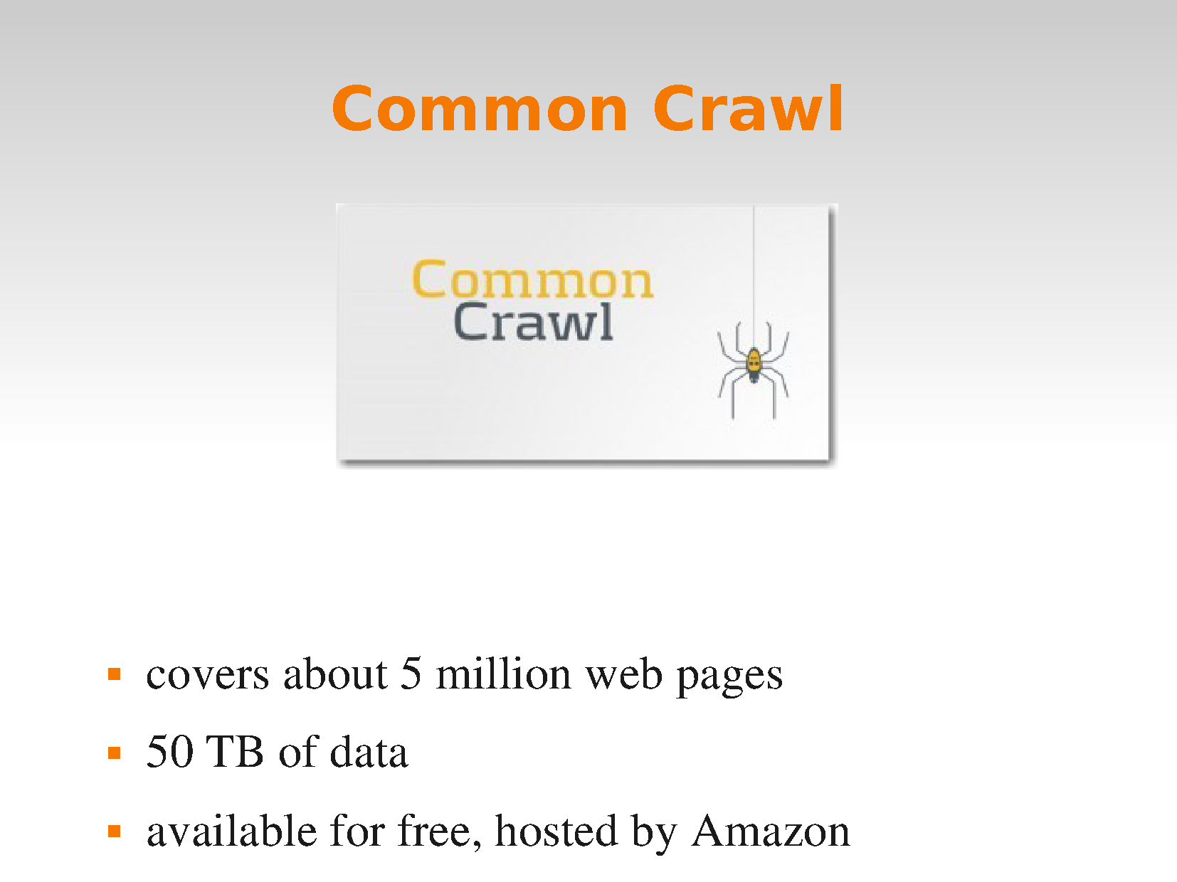

Slide 11
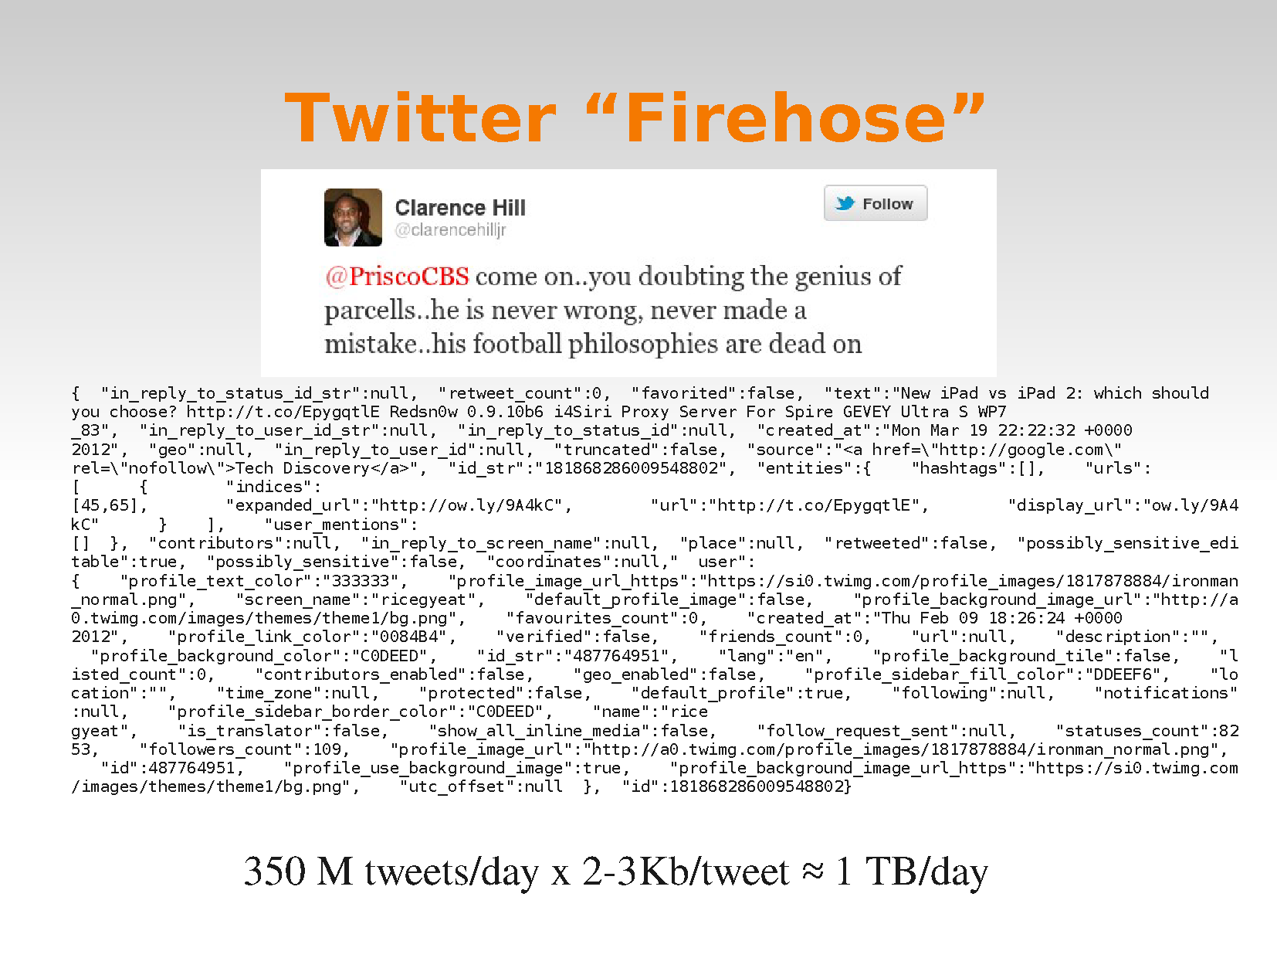

Slide 12
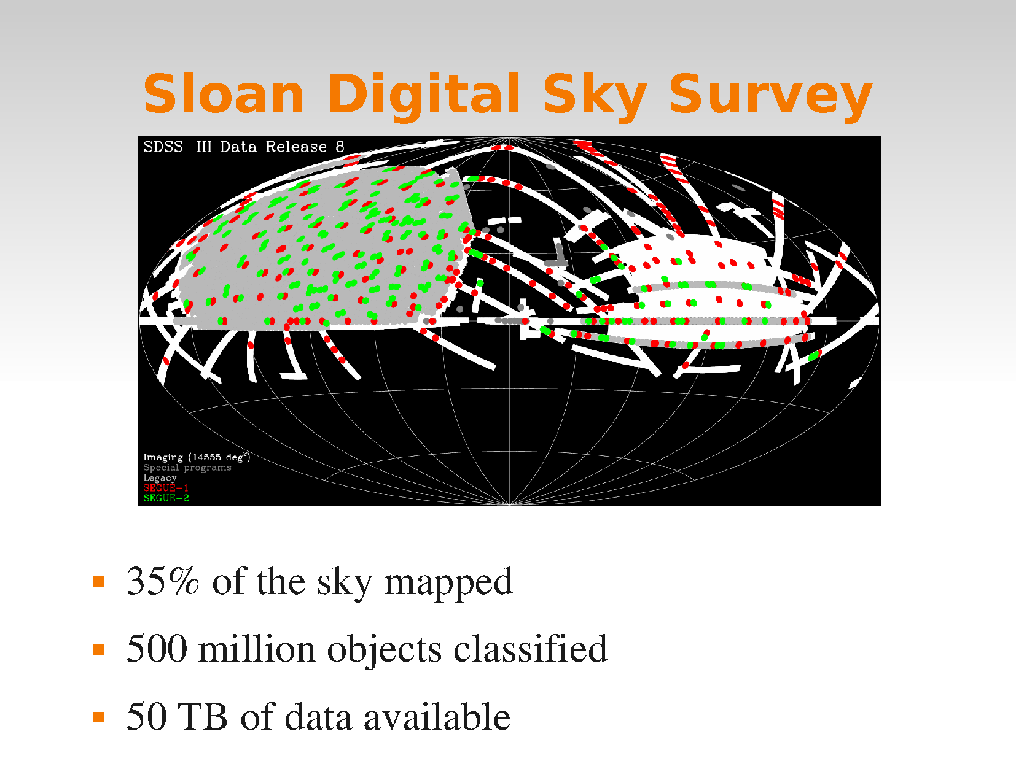

Slide 13
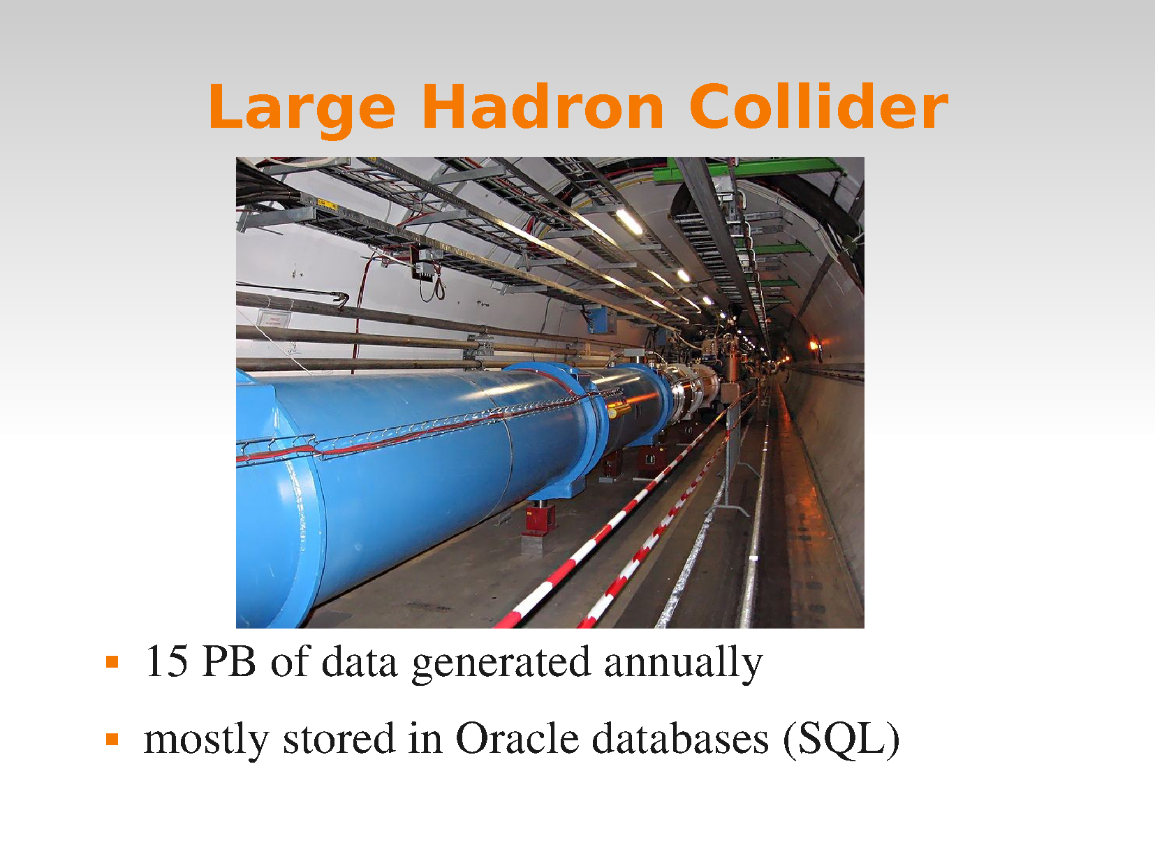

Slide 14
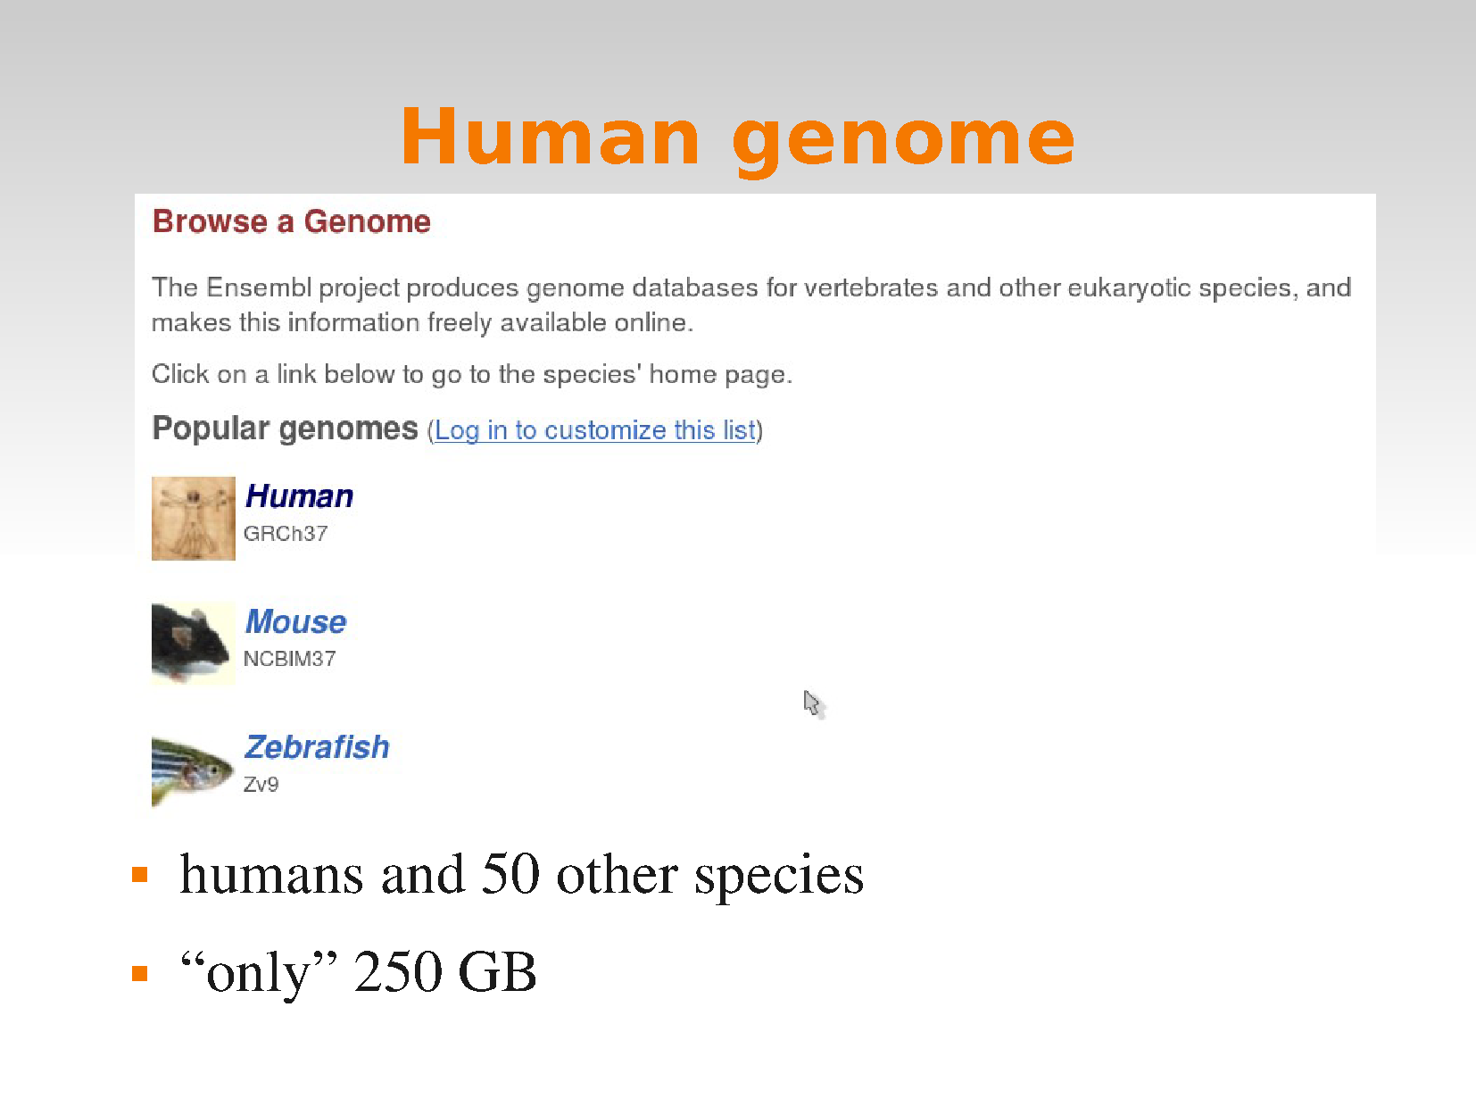

Slide 15
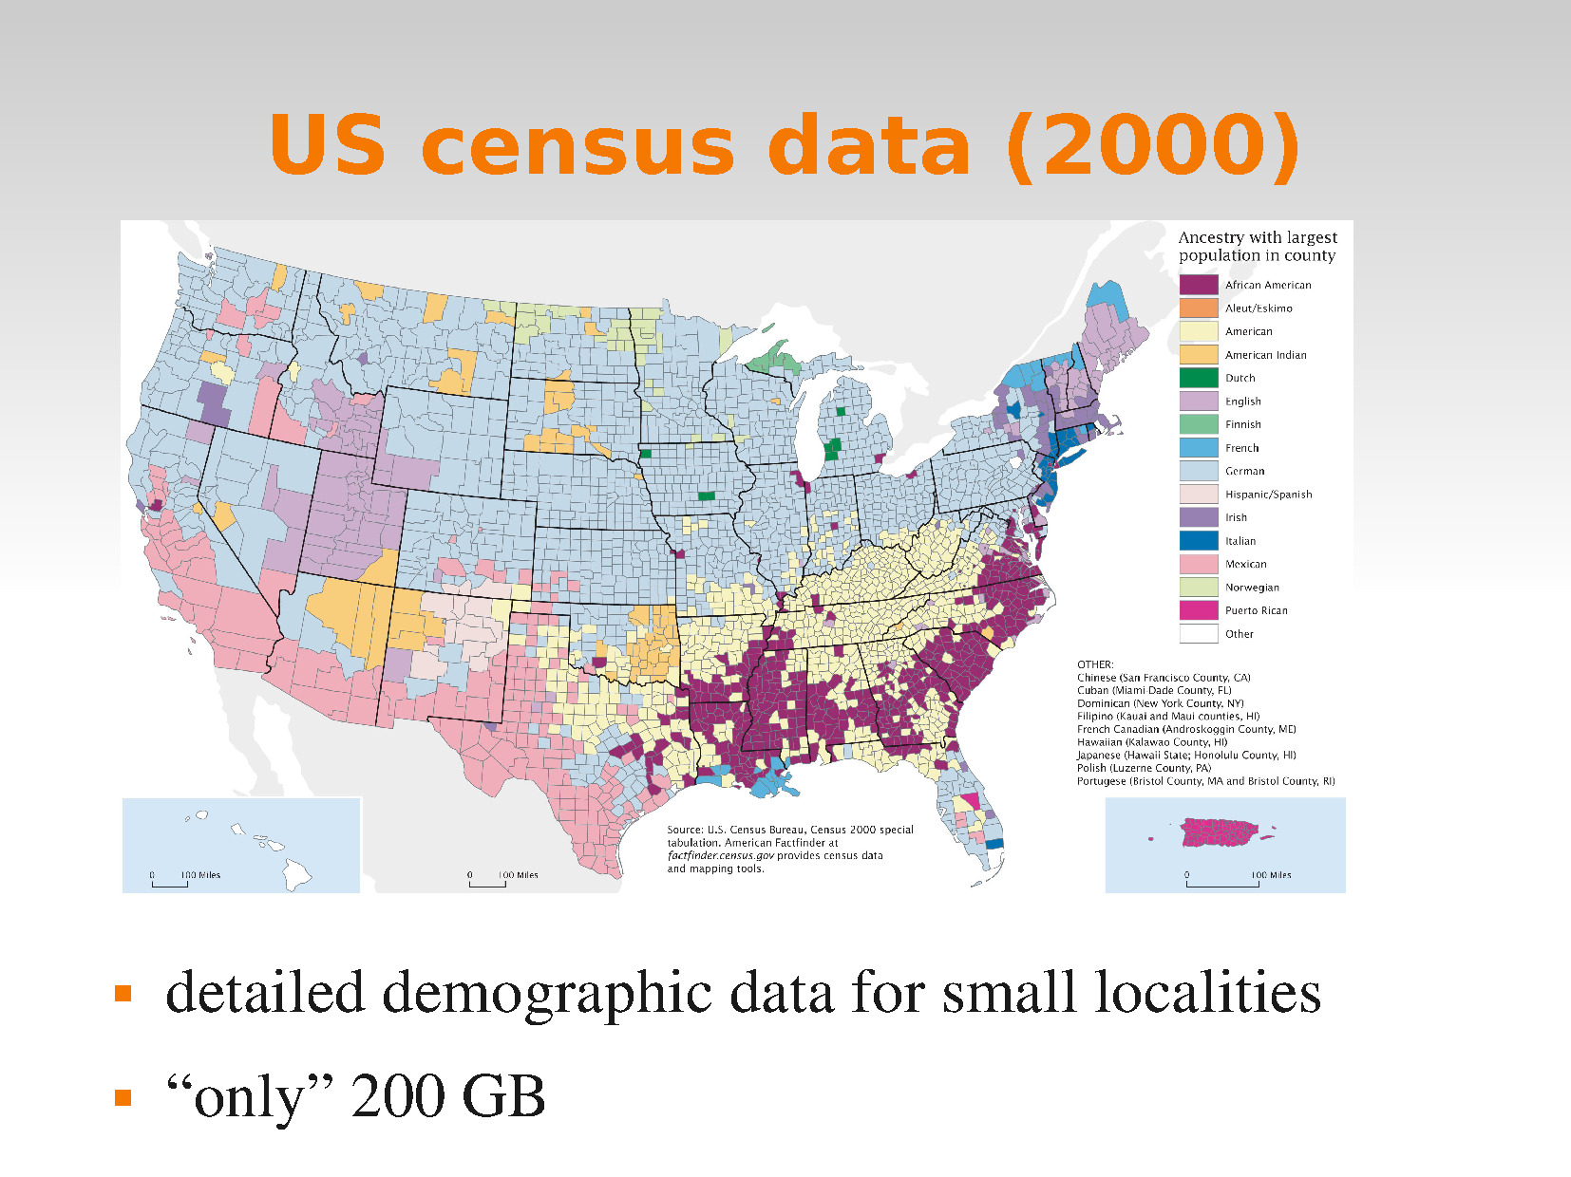

Slide 16
Storing BIG DATA

Slide 17
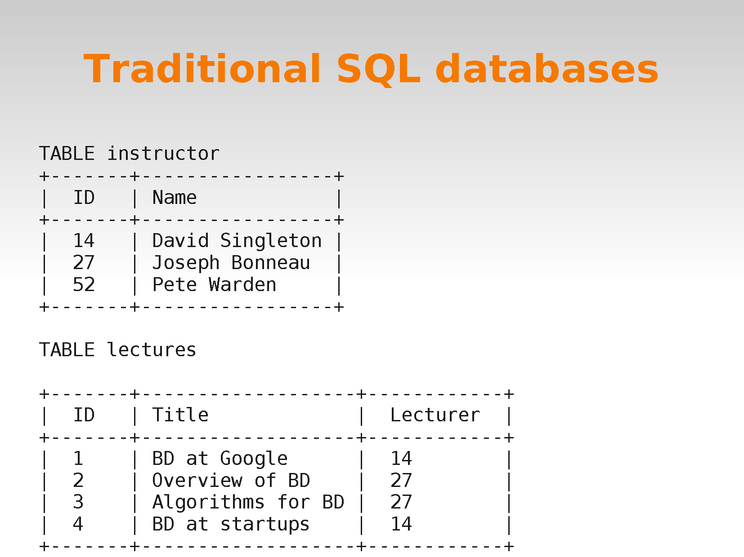

Slide 18
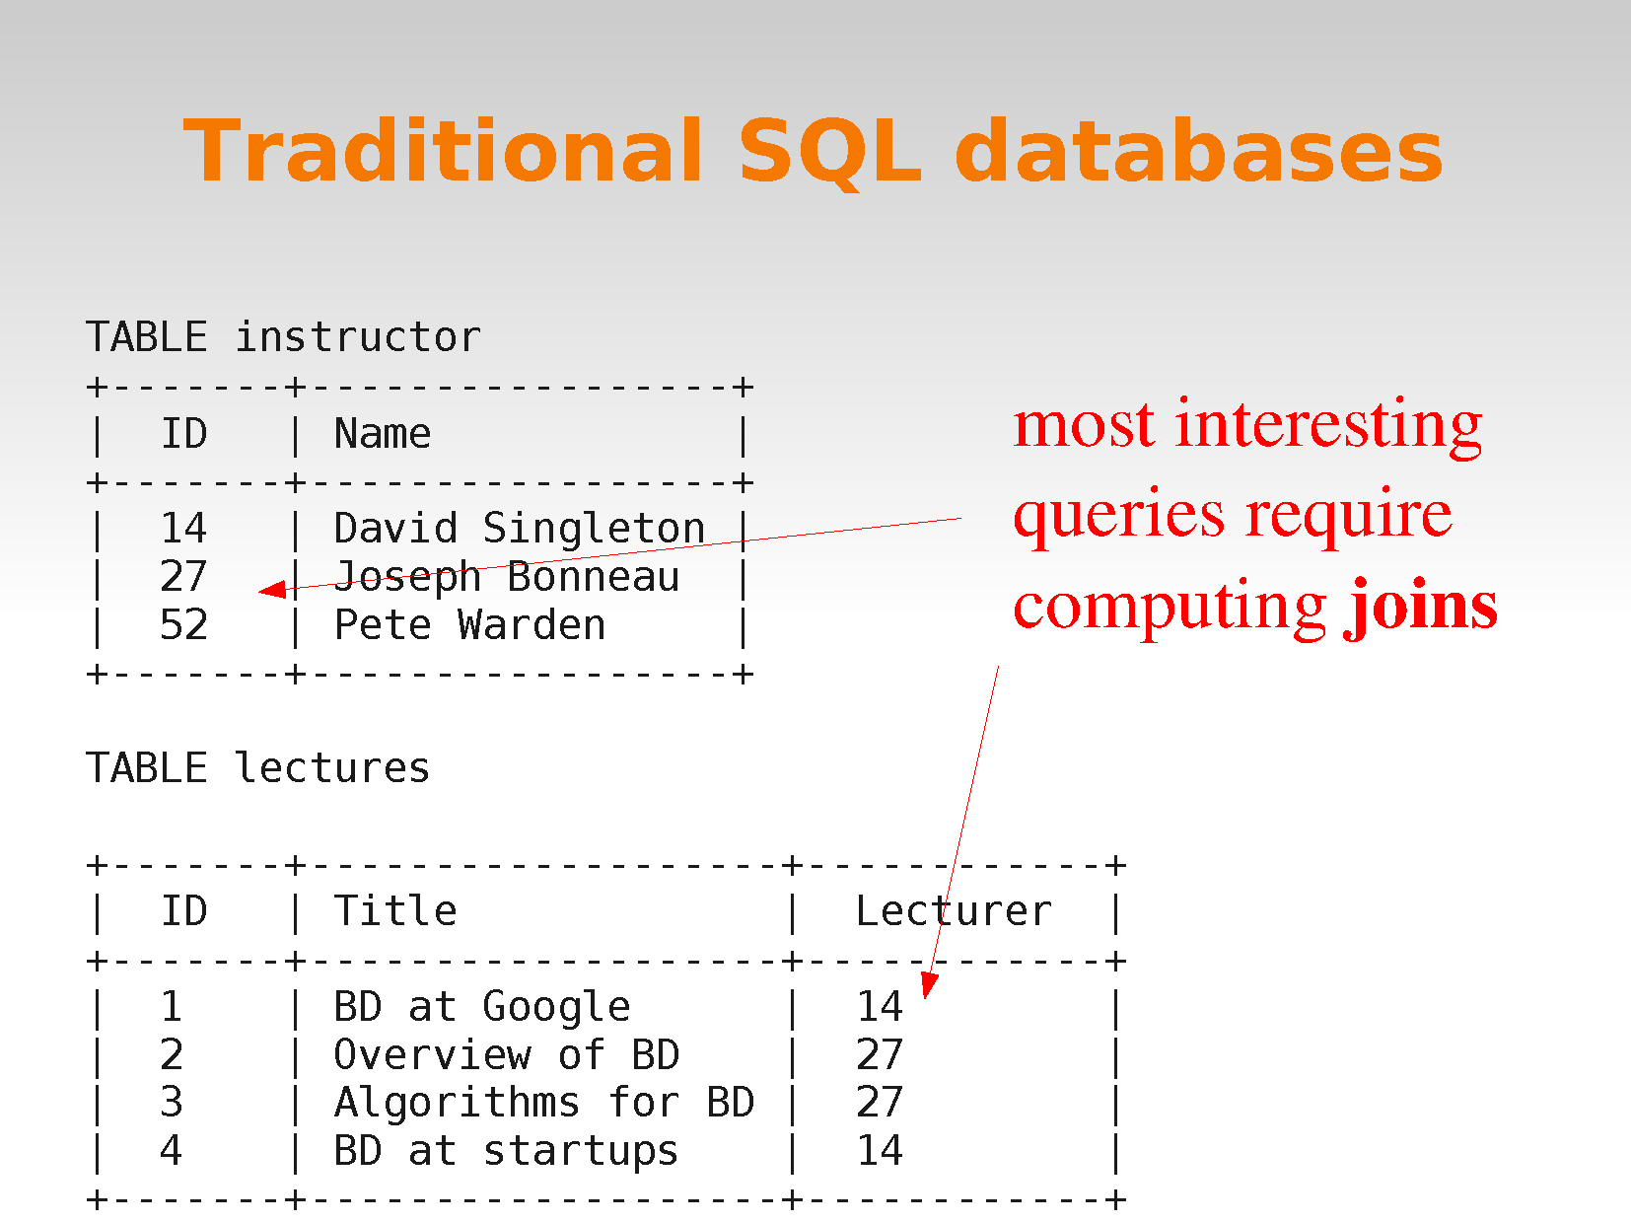

Slide 19
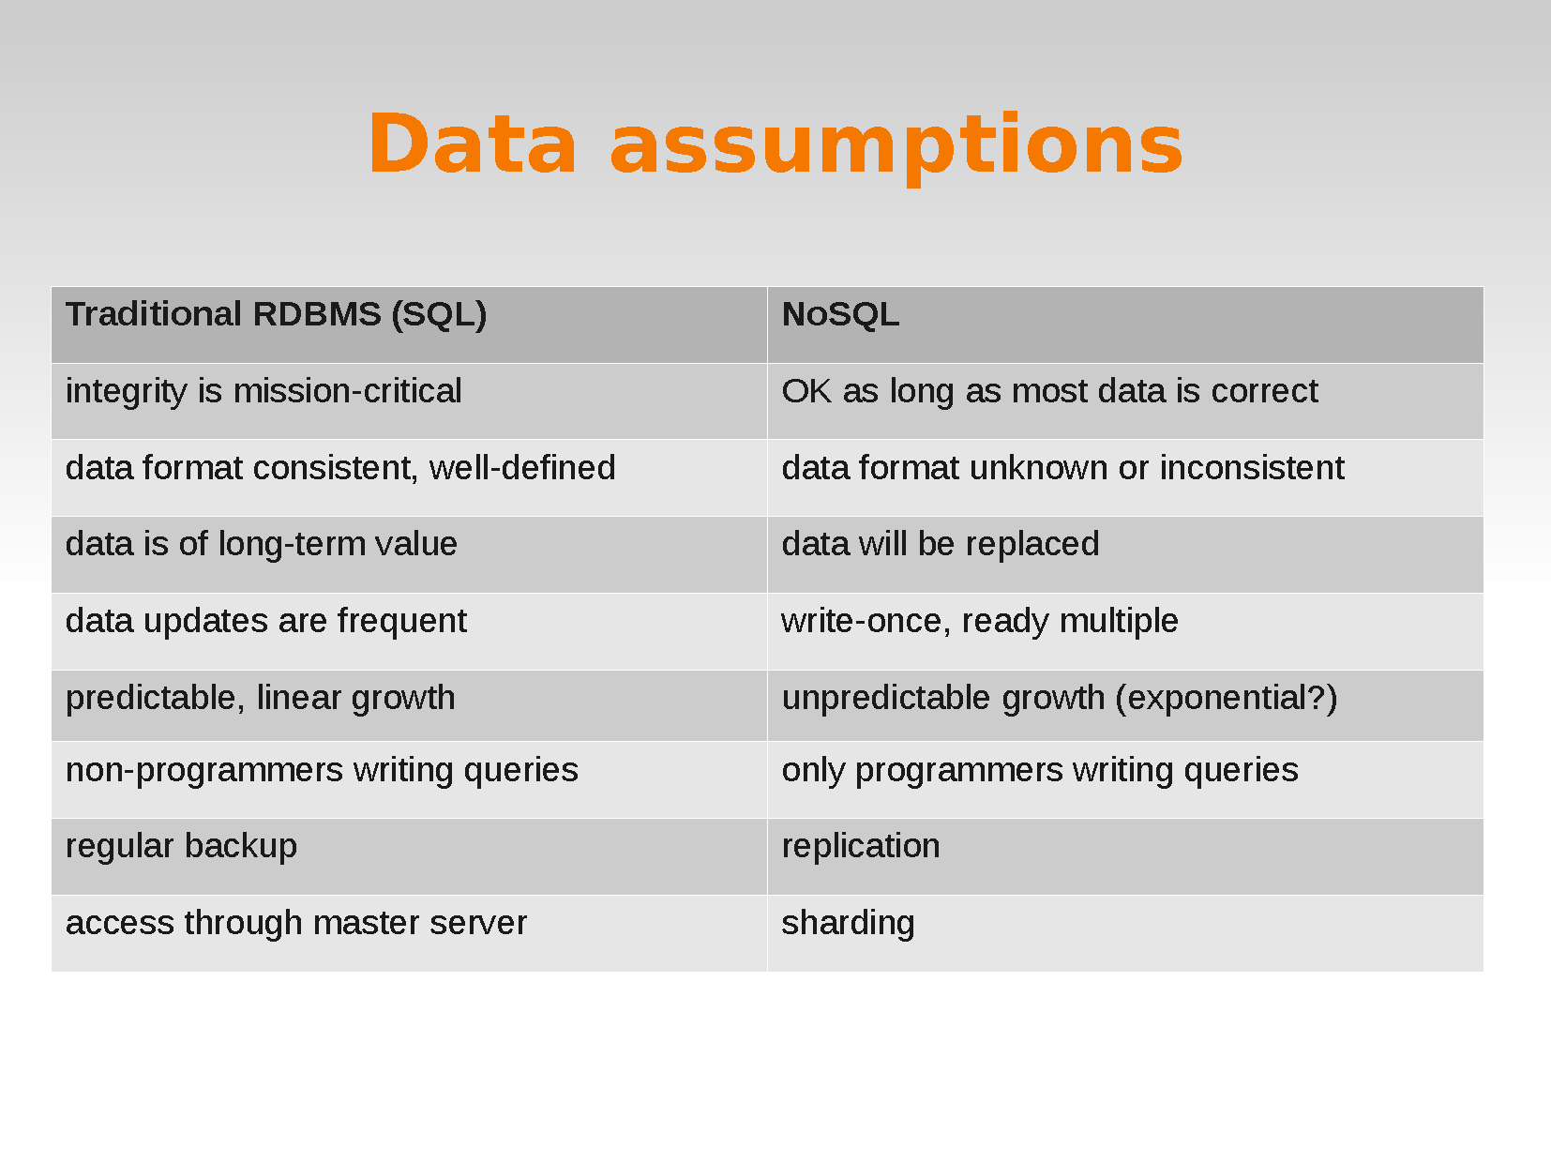

Slide 20
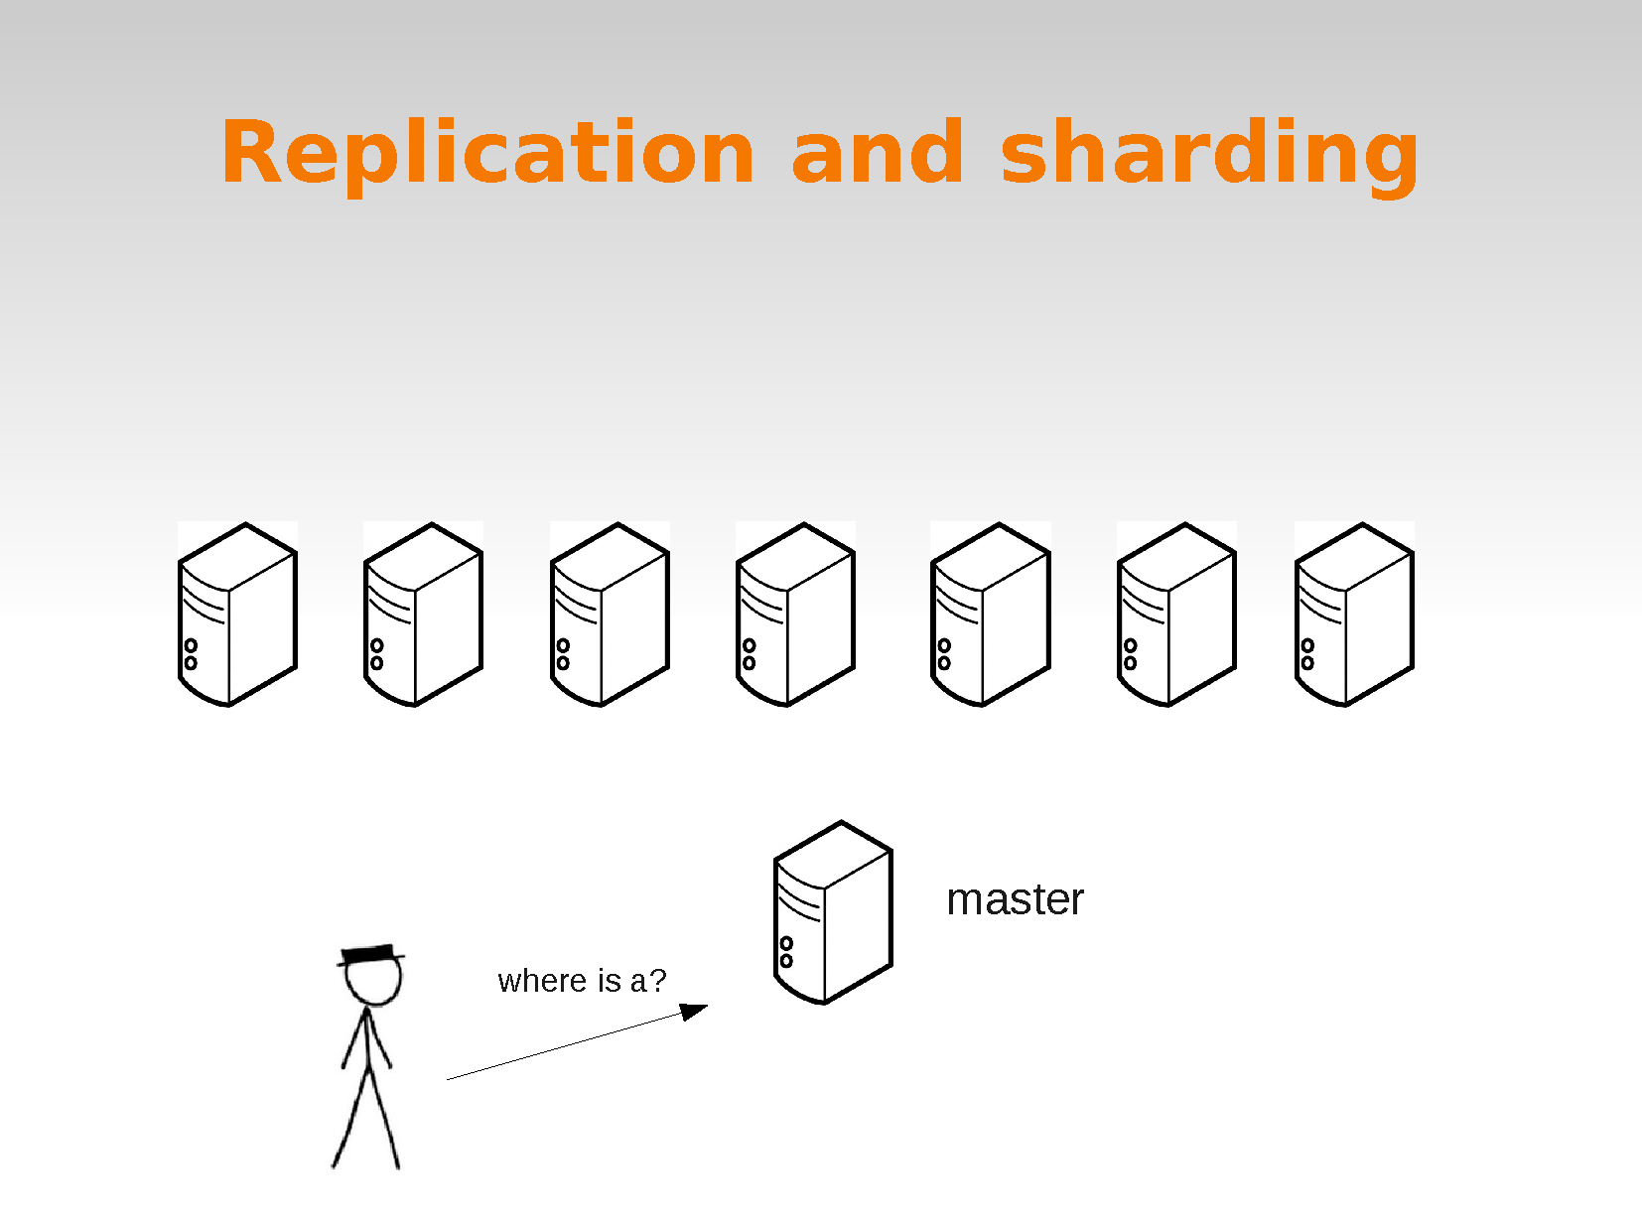

Slide 21


Slide 22
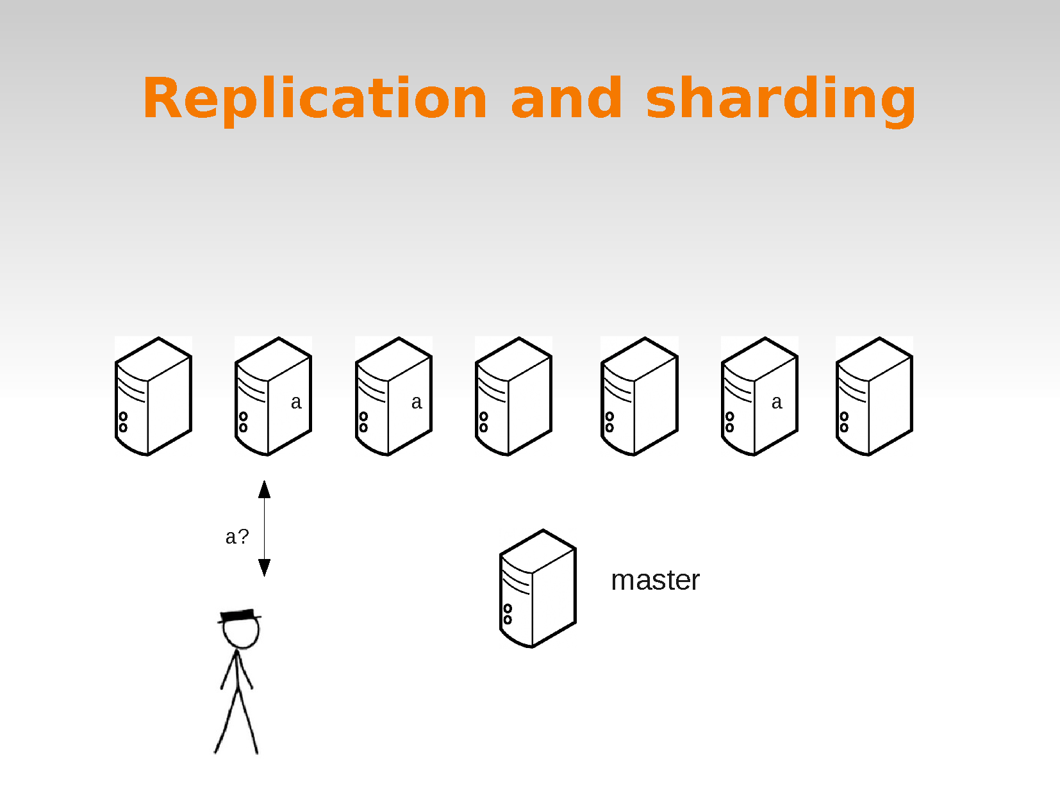

Slide 23
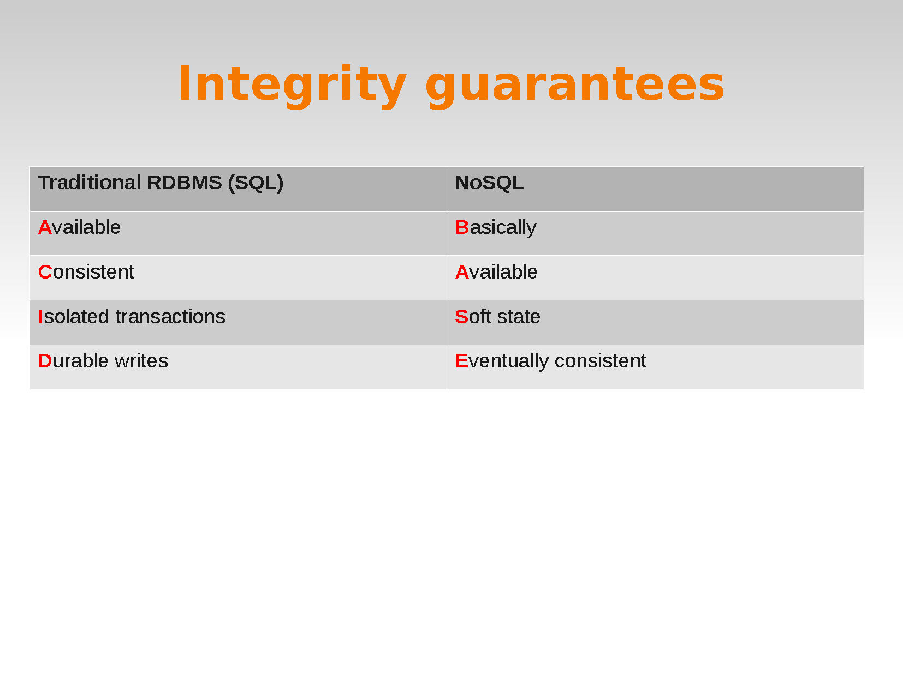

Slide 24
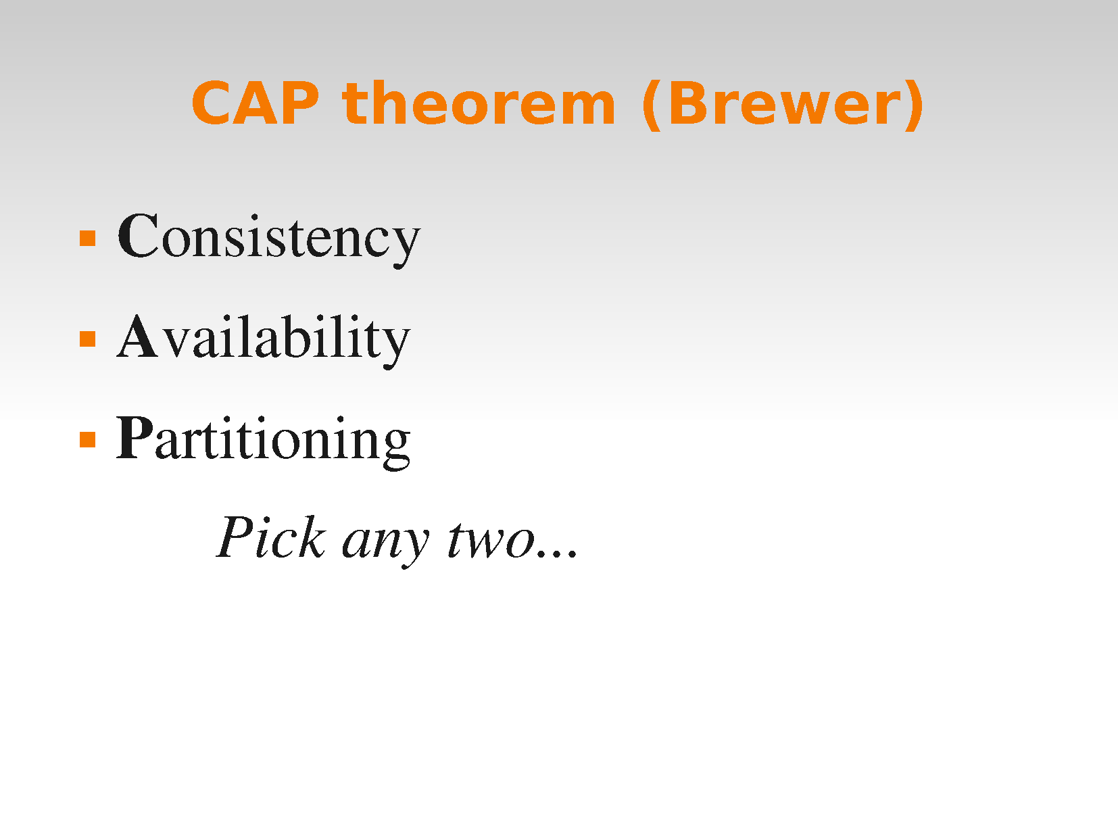

Slide 25
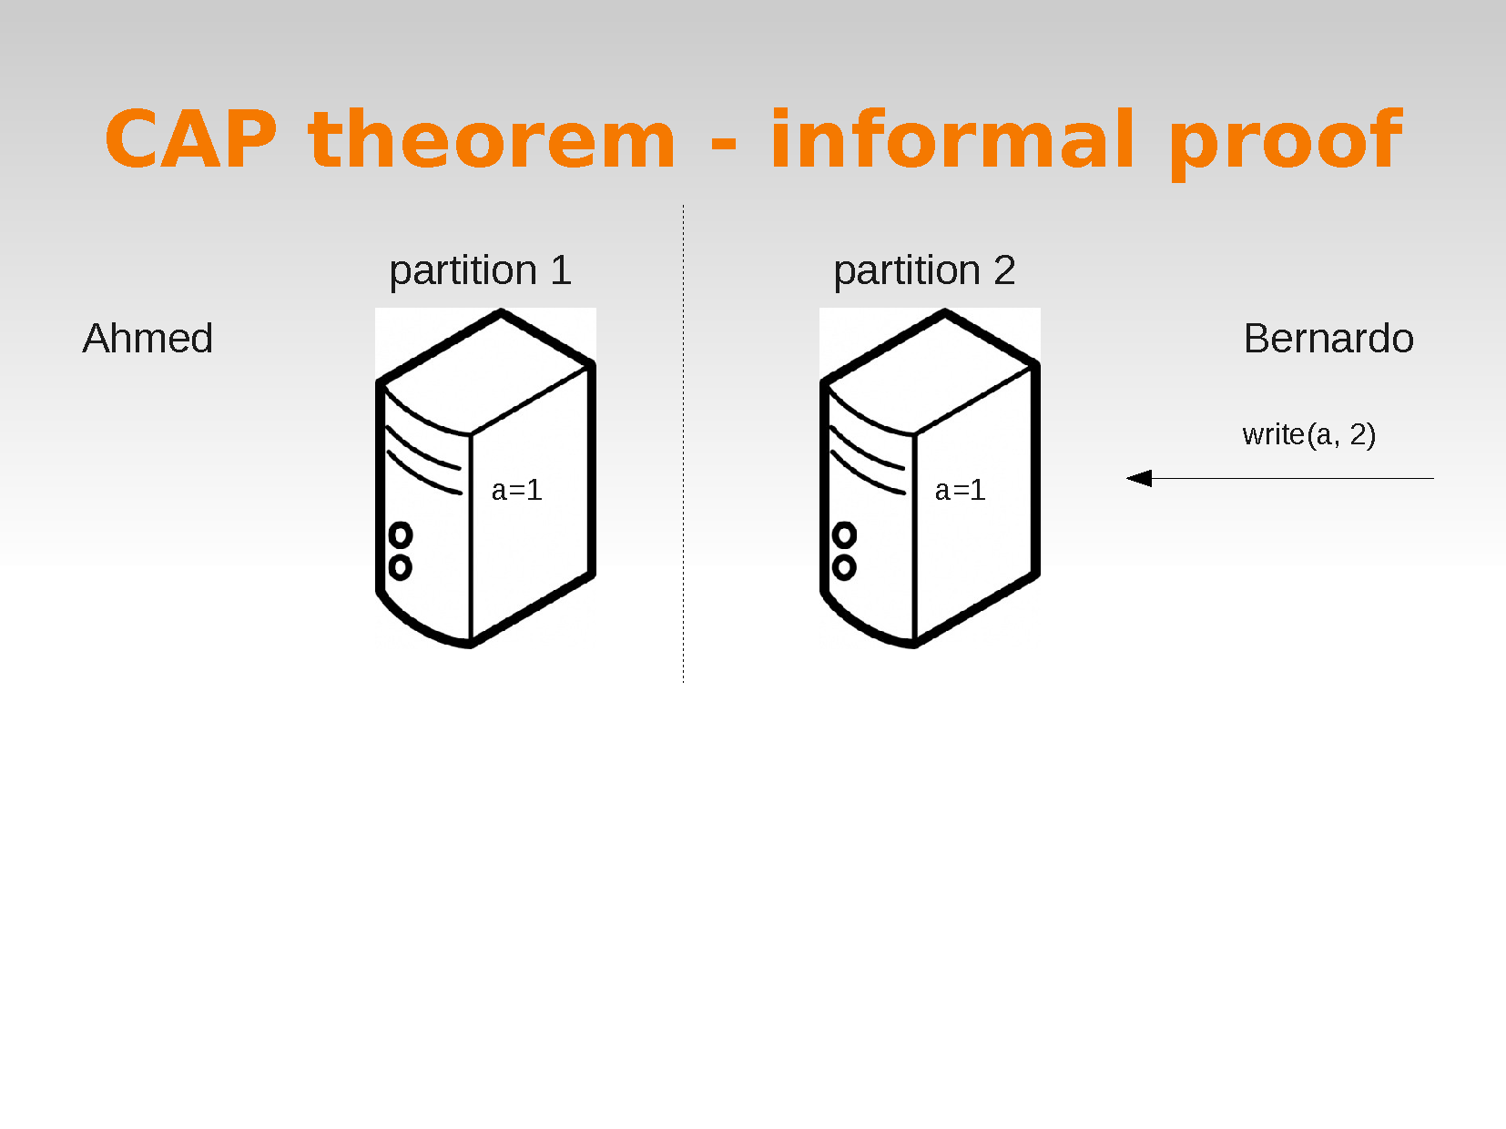

Slide 26
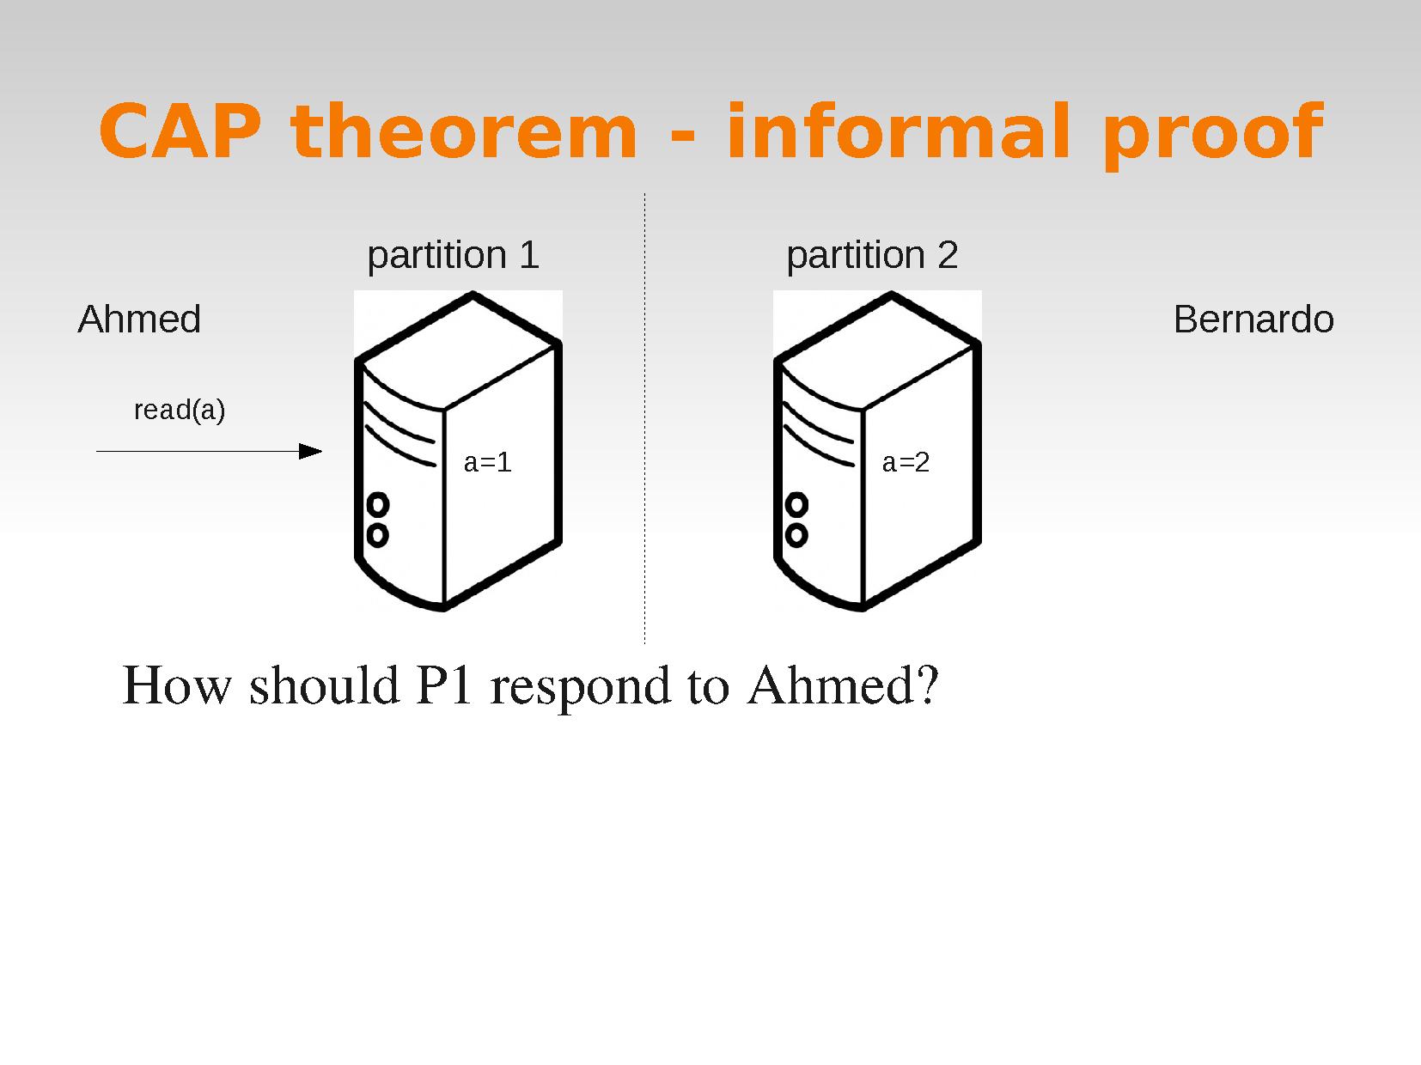

Slide 27
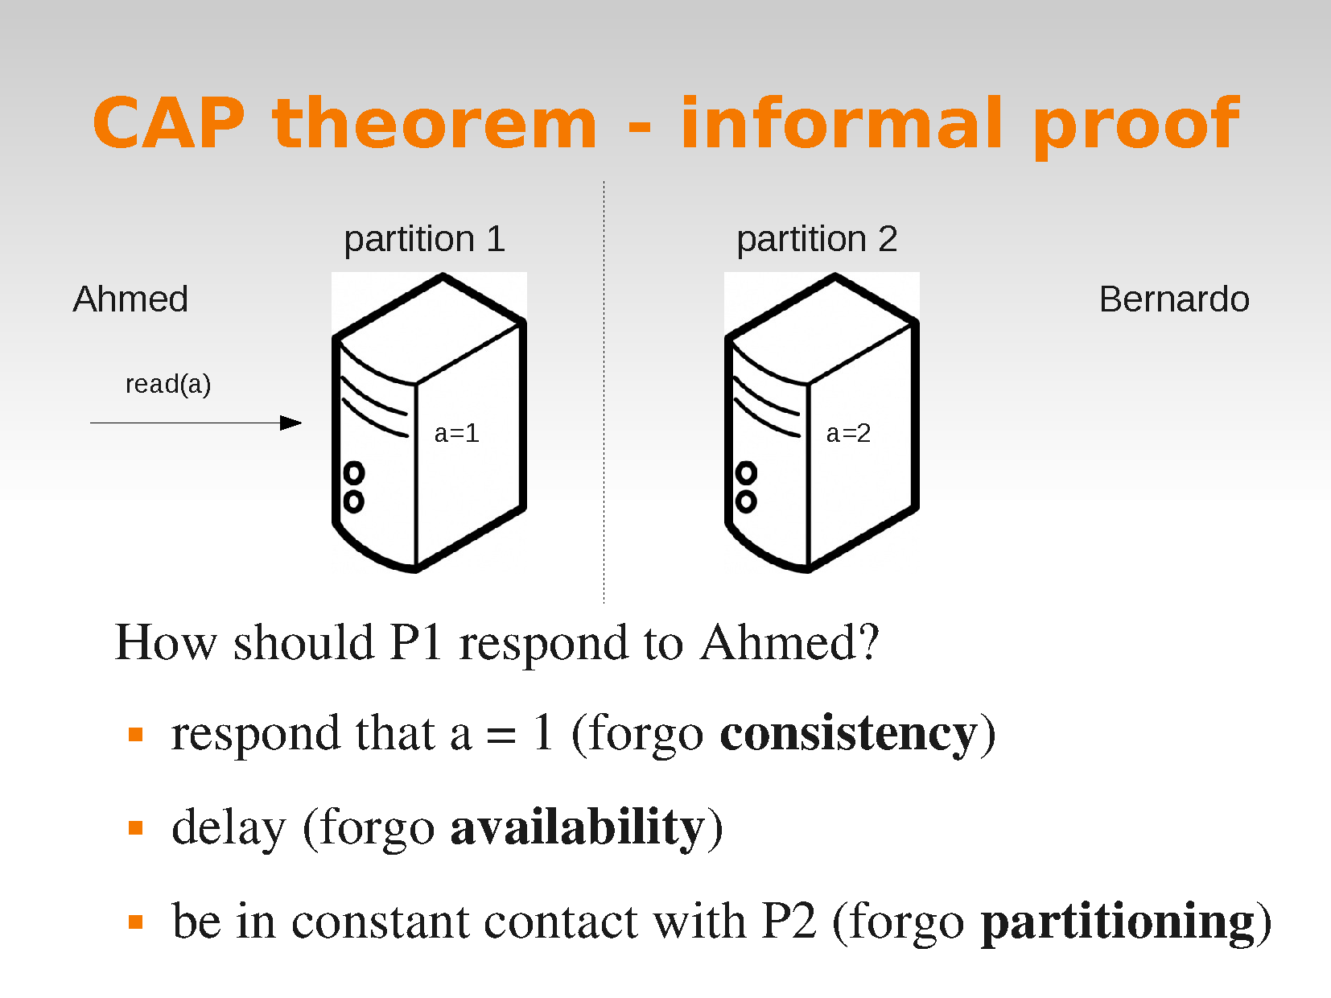

Slide 28
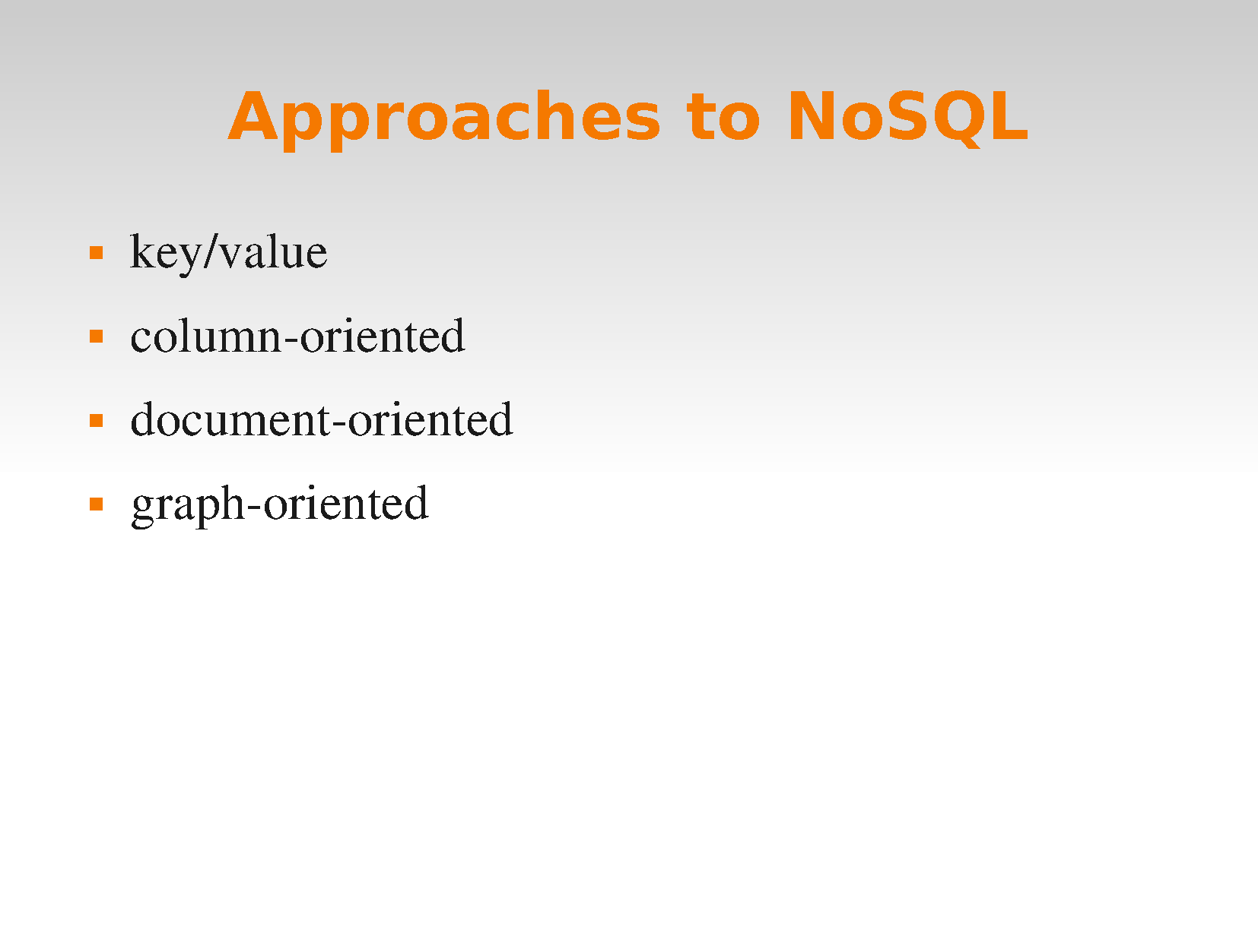

Slide 29
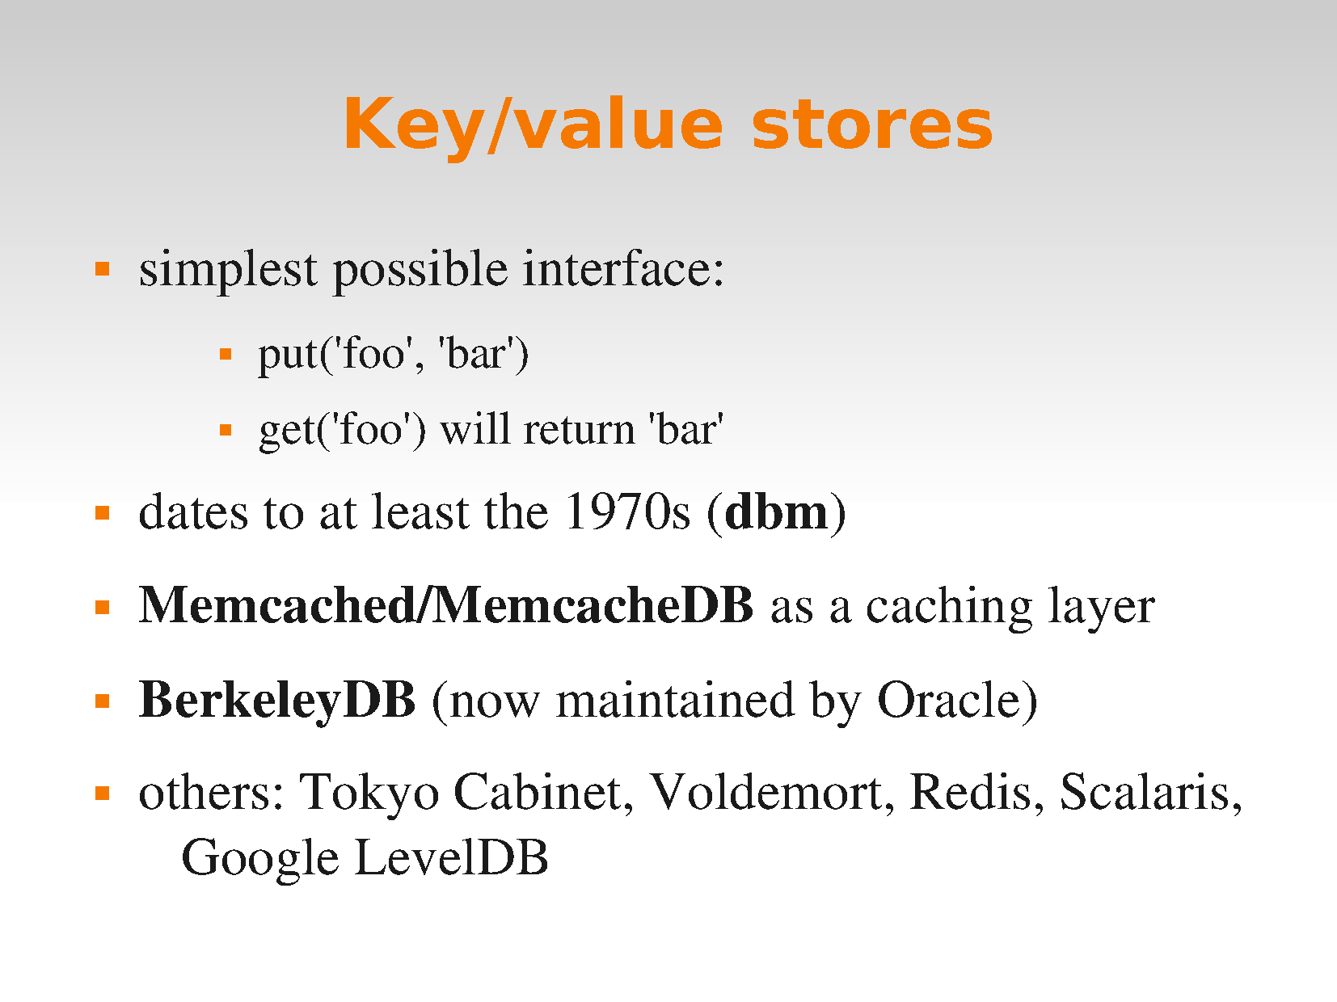

Slide 30
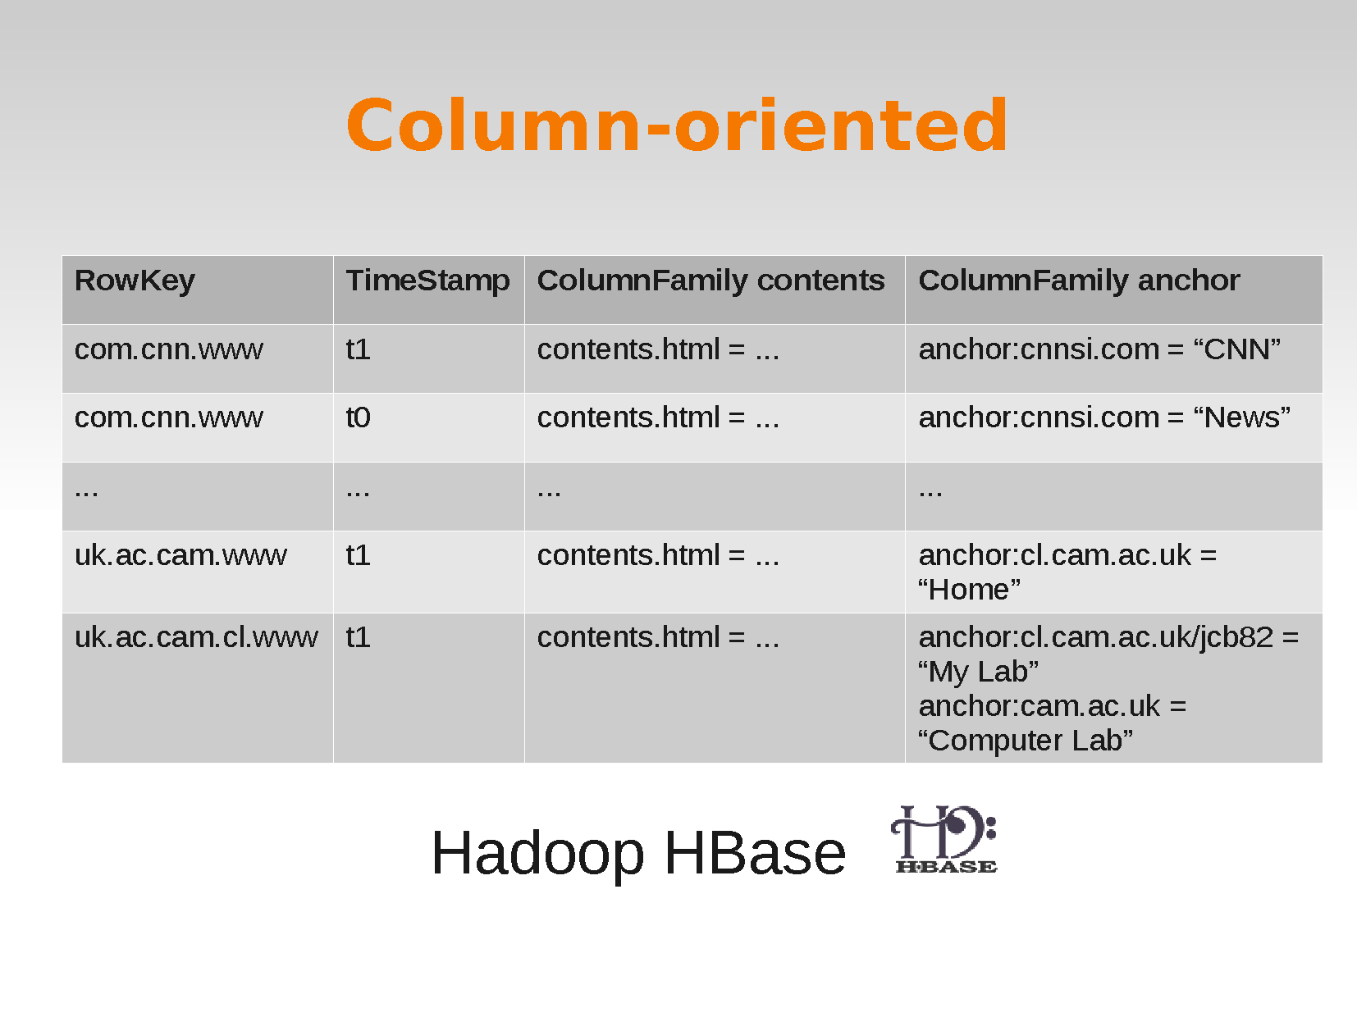

Slide 31
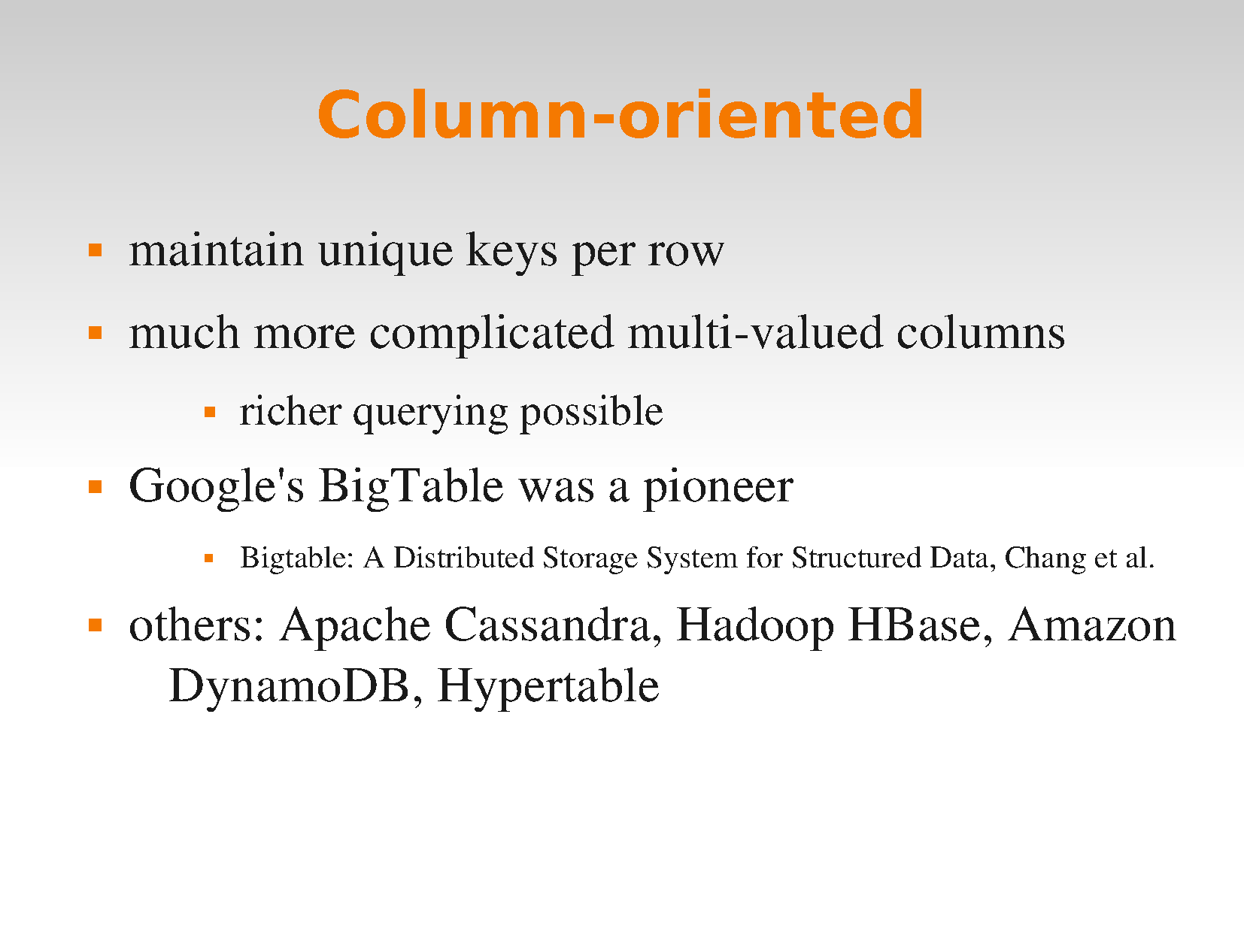

Slide 32
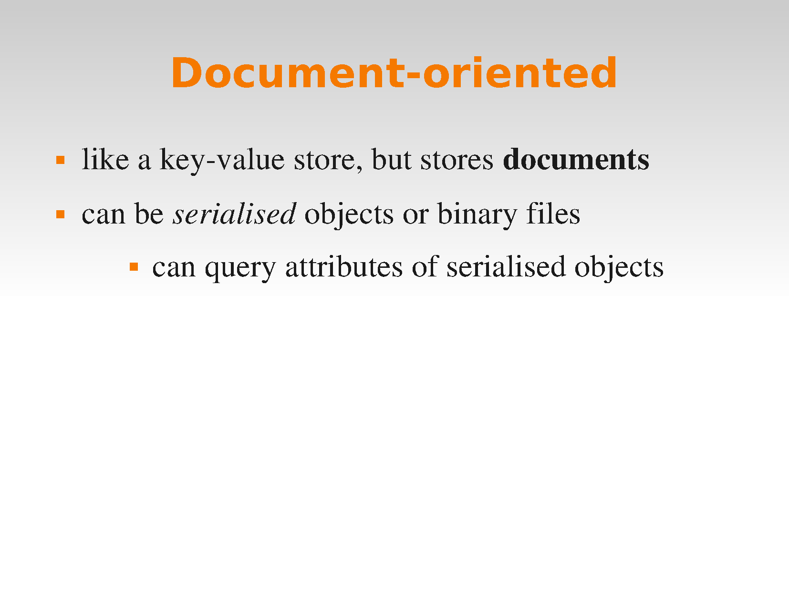

Slide 33
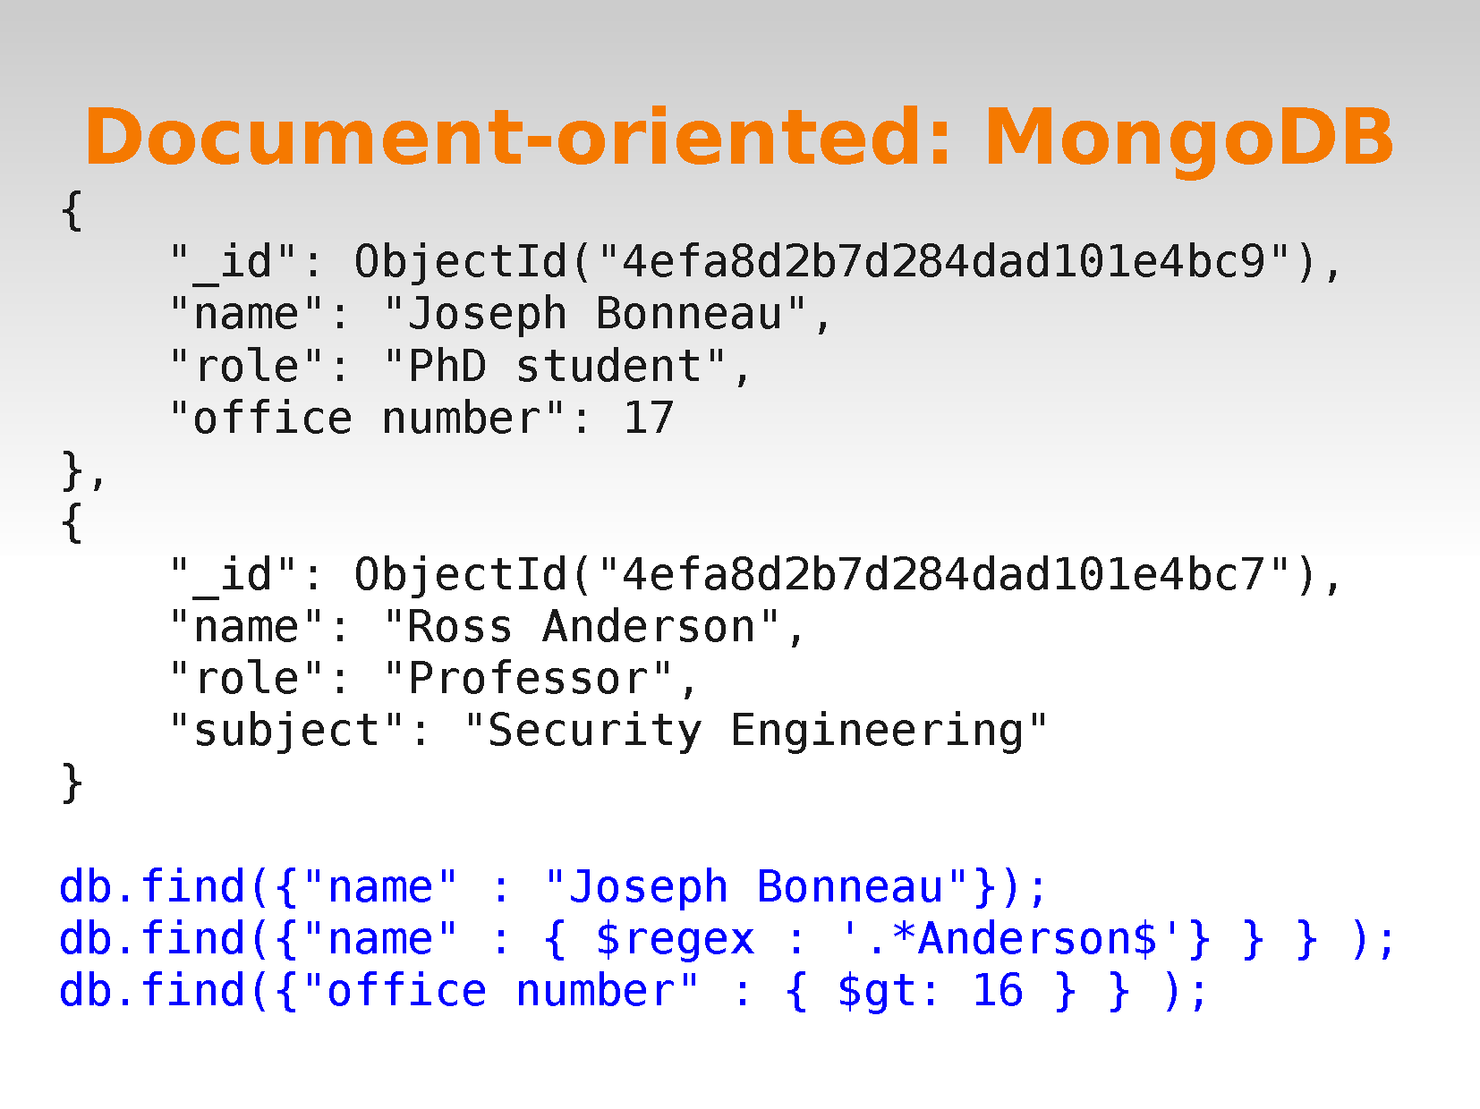

Slide 34
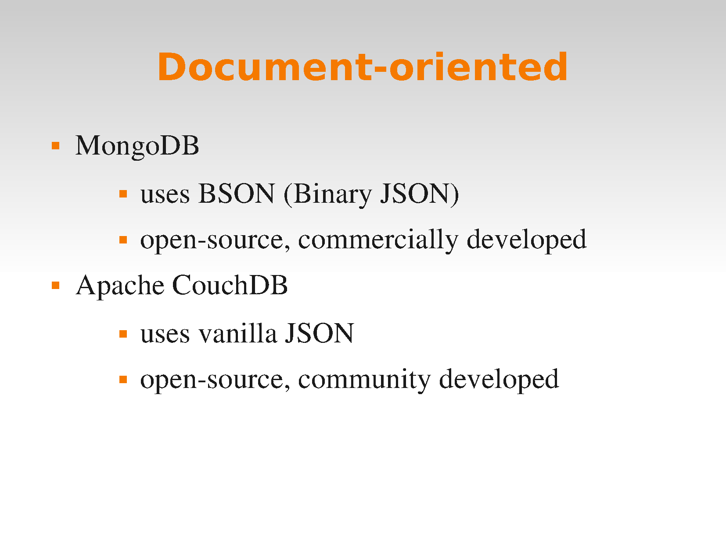

Slide 35
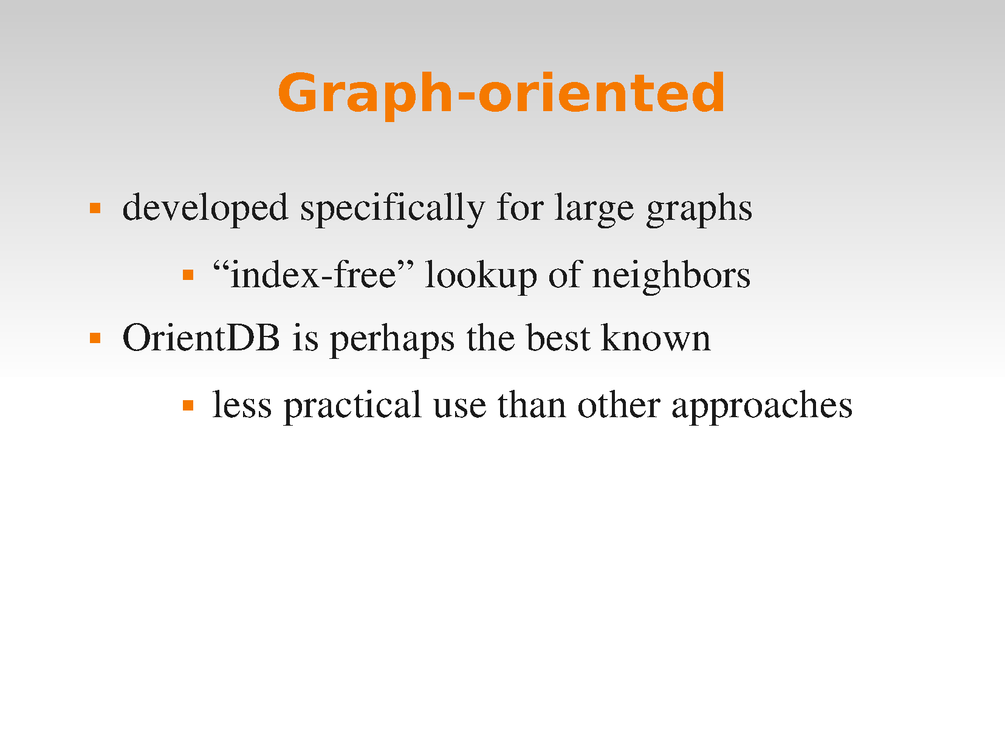

Slide 36
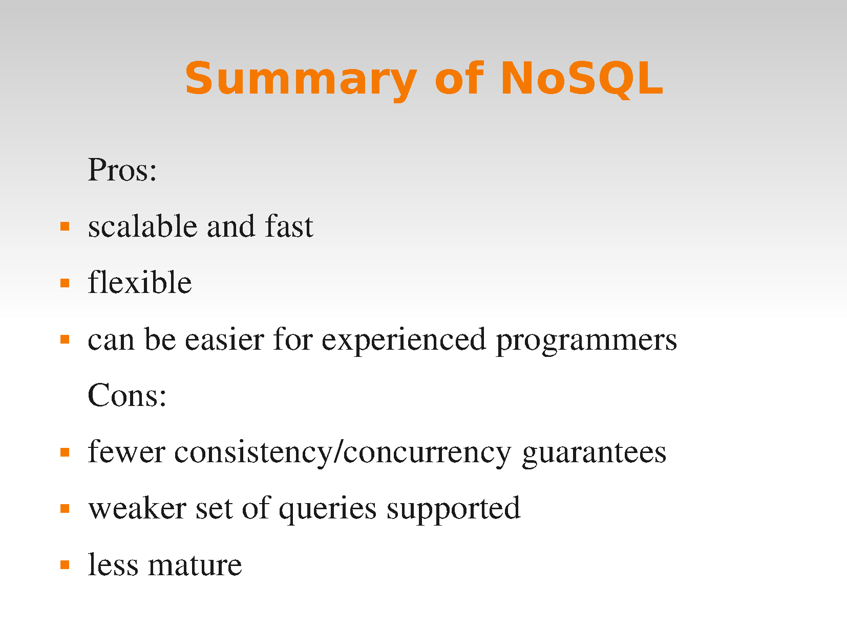

Slide 37
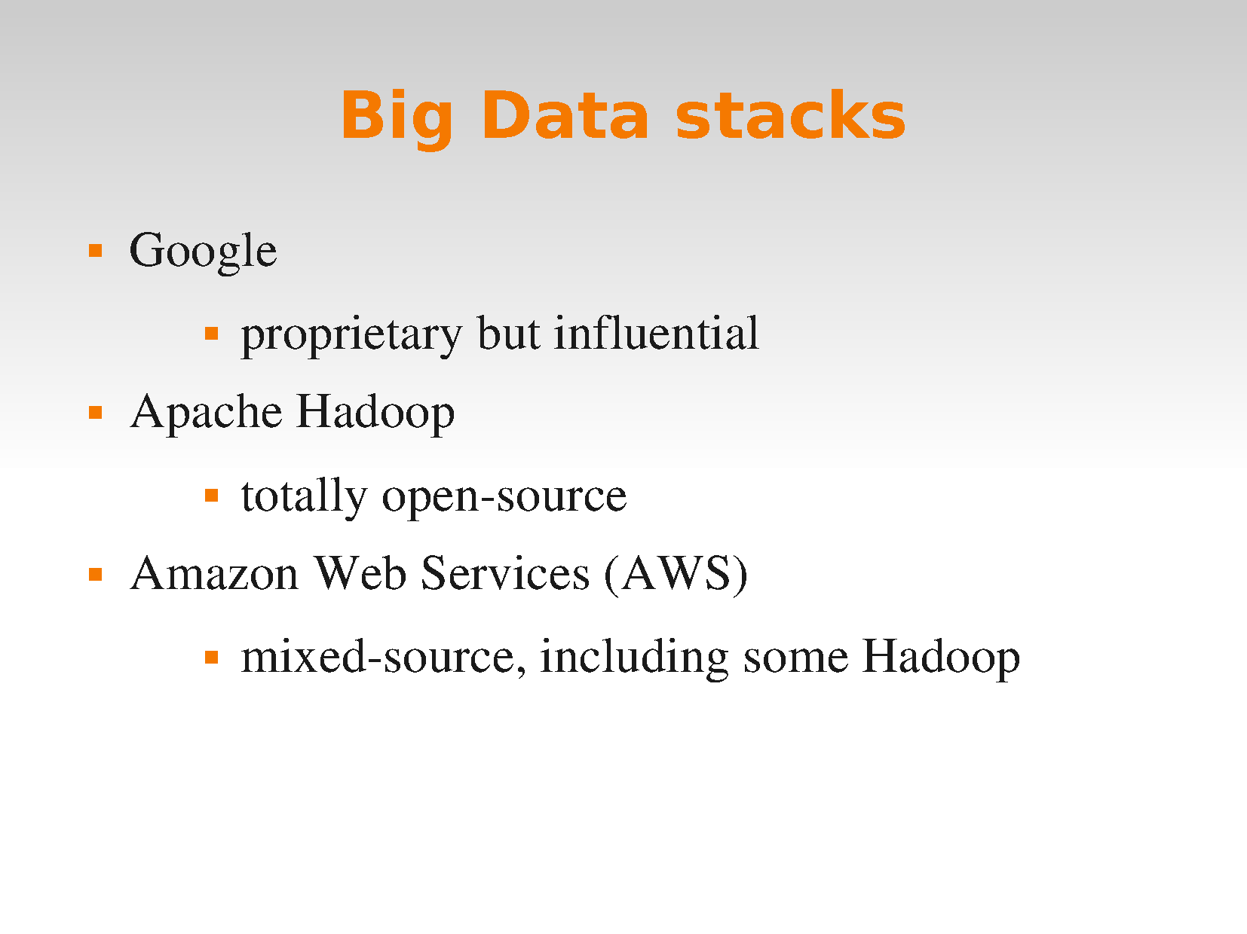

Slide 38
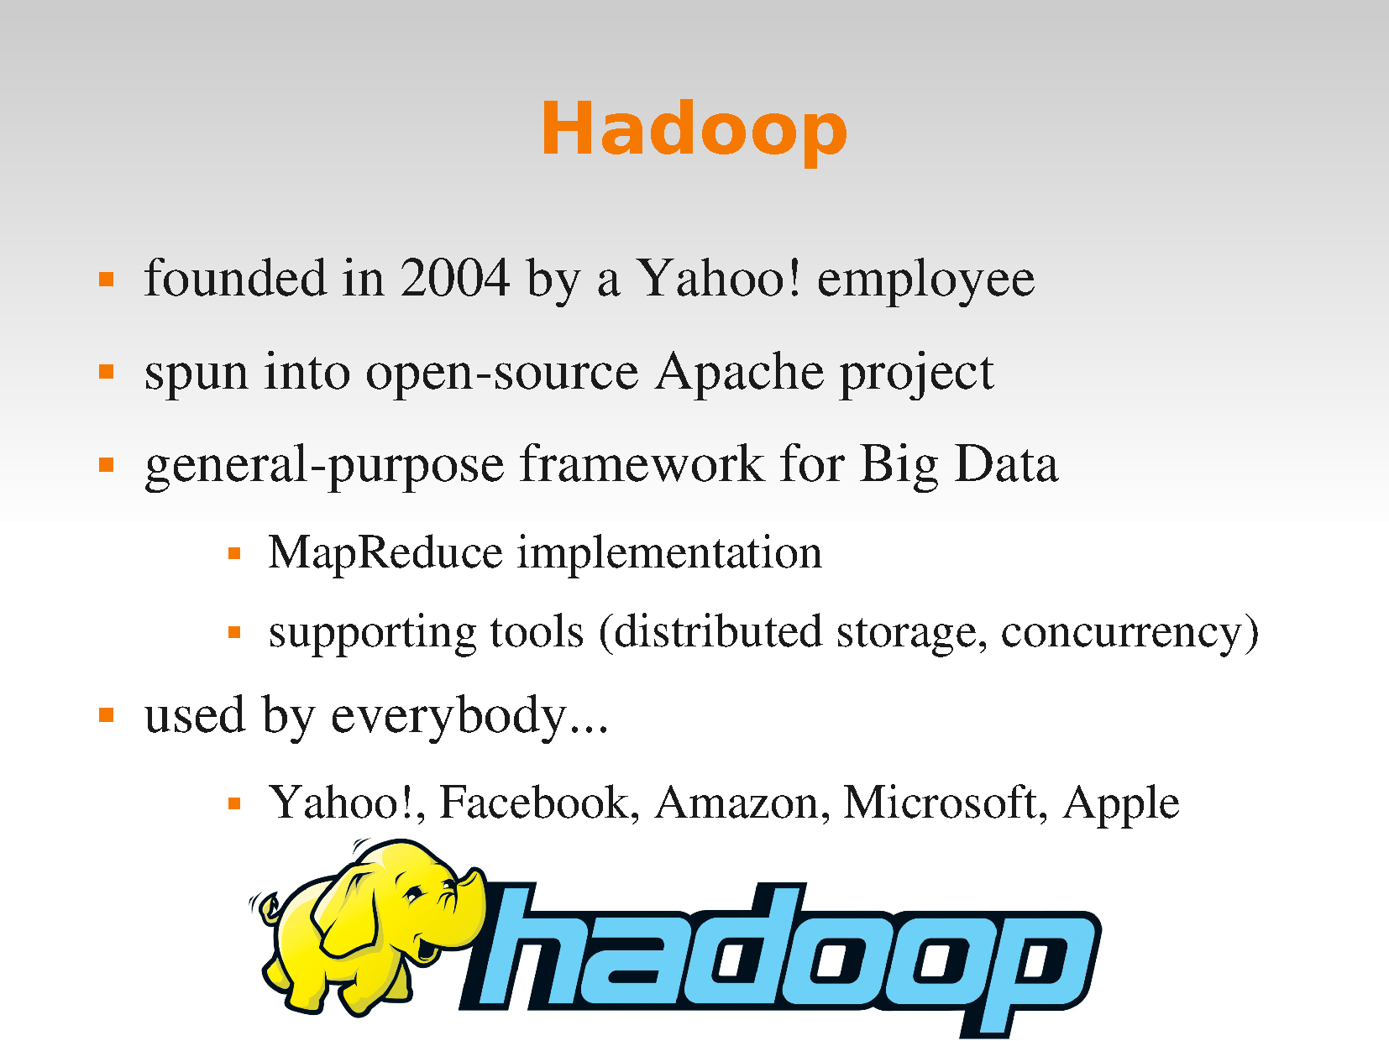

Slide 39
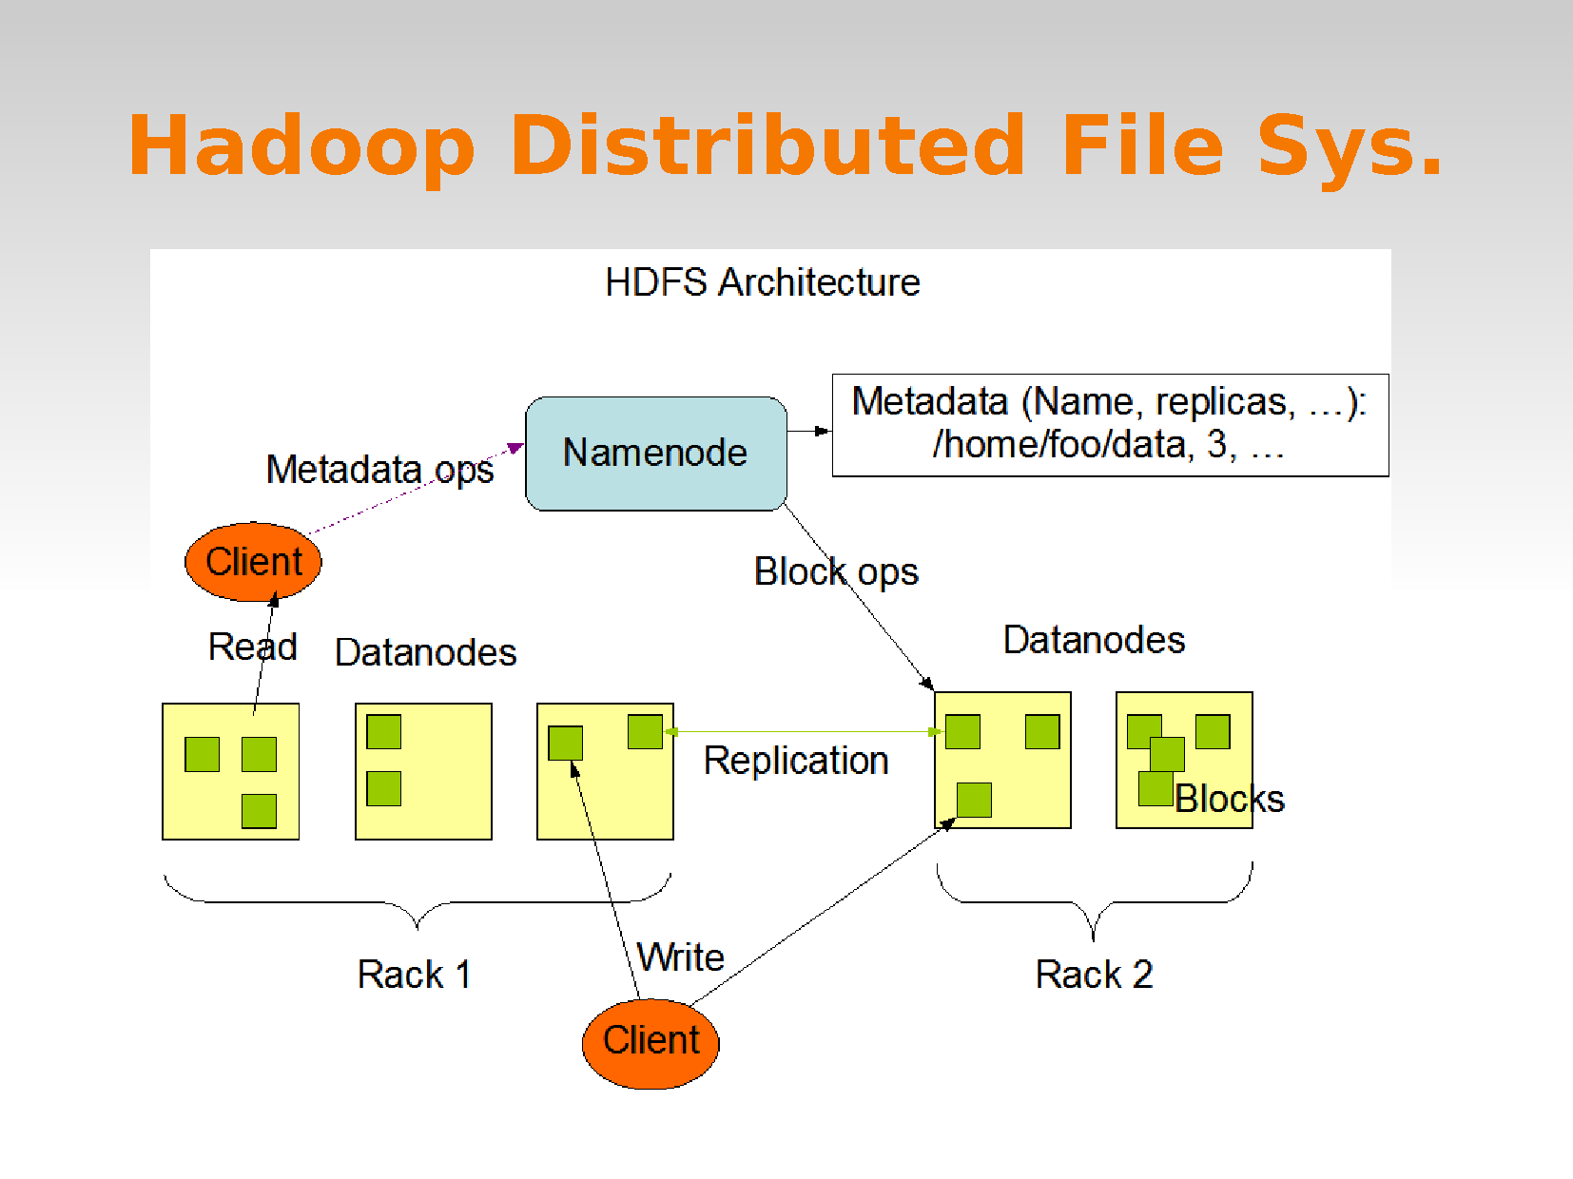

Slide 40
MapReduce
MapReduce is a programming model and an associated implementation for processing and generating large data sets with a parallel, distributed algorithm on a cluster.
A MapReduce program is composed of a Map() procedure that performs filtering and sorting (such as sorting students by first name into queues, one queue for each name) and a Reduce() procedure that performs a summary operation (such as counting the number of students in each queue, yielding name frequencies).

Slide 41
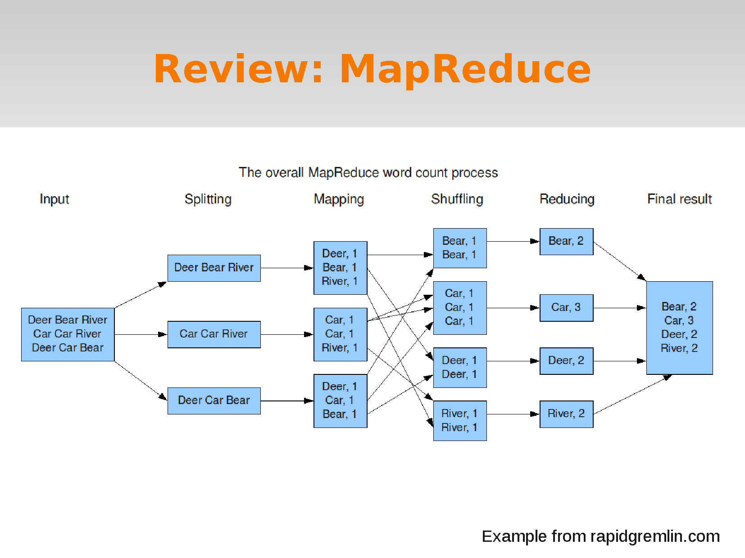

Slide 42


Slide 43
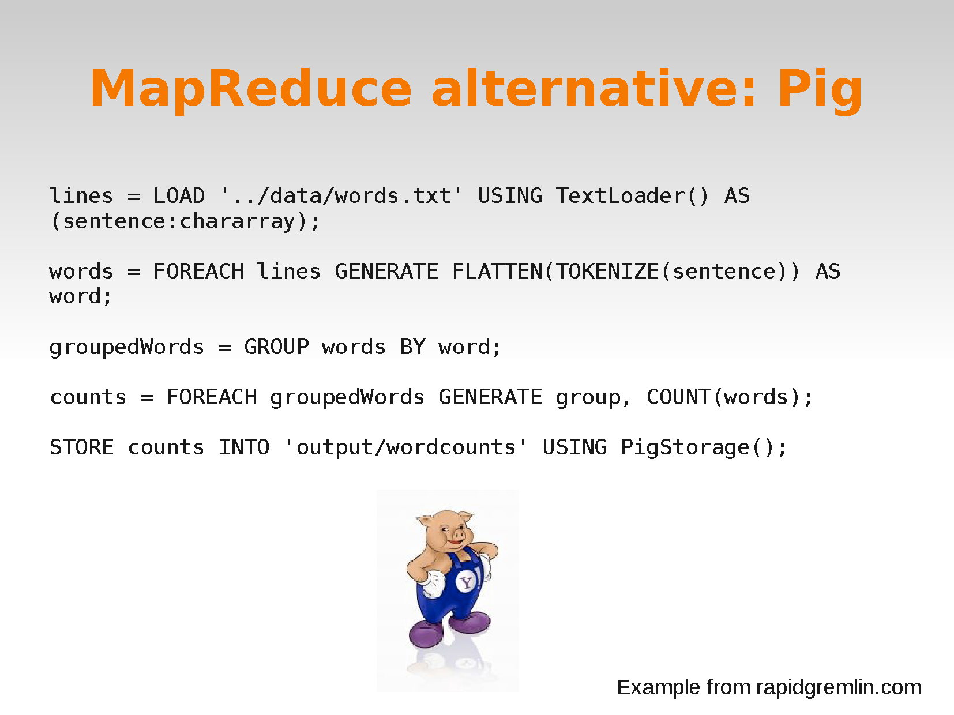

Slide 44
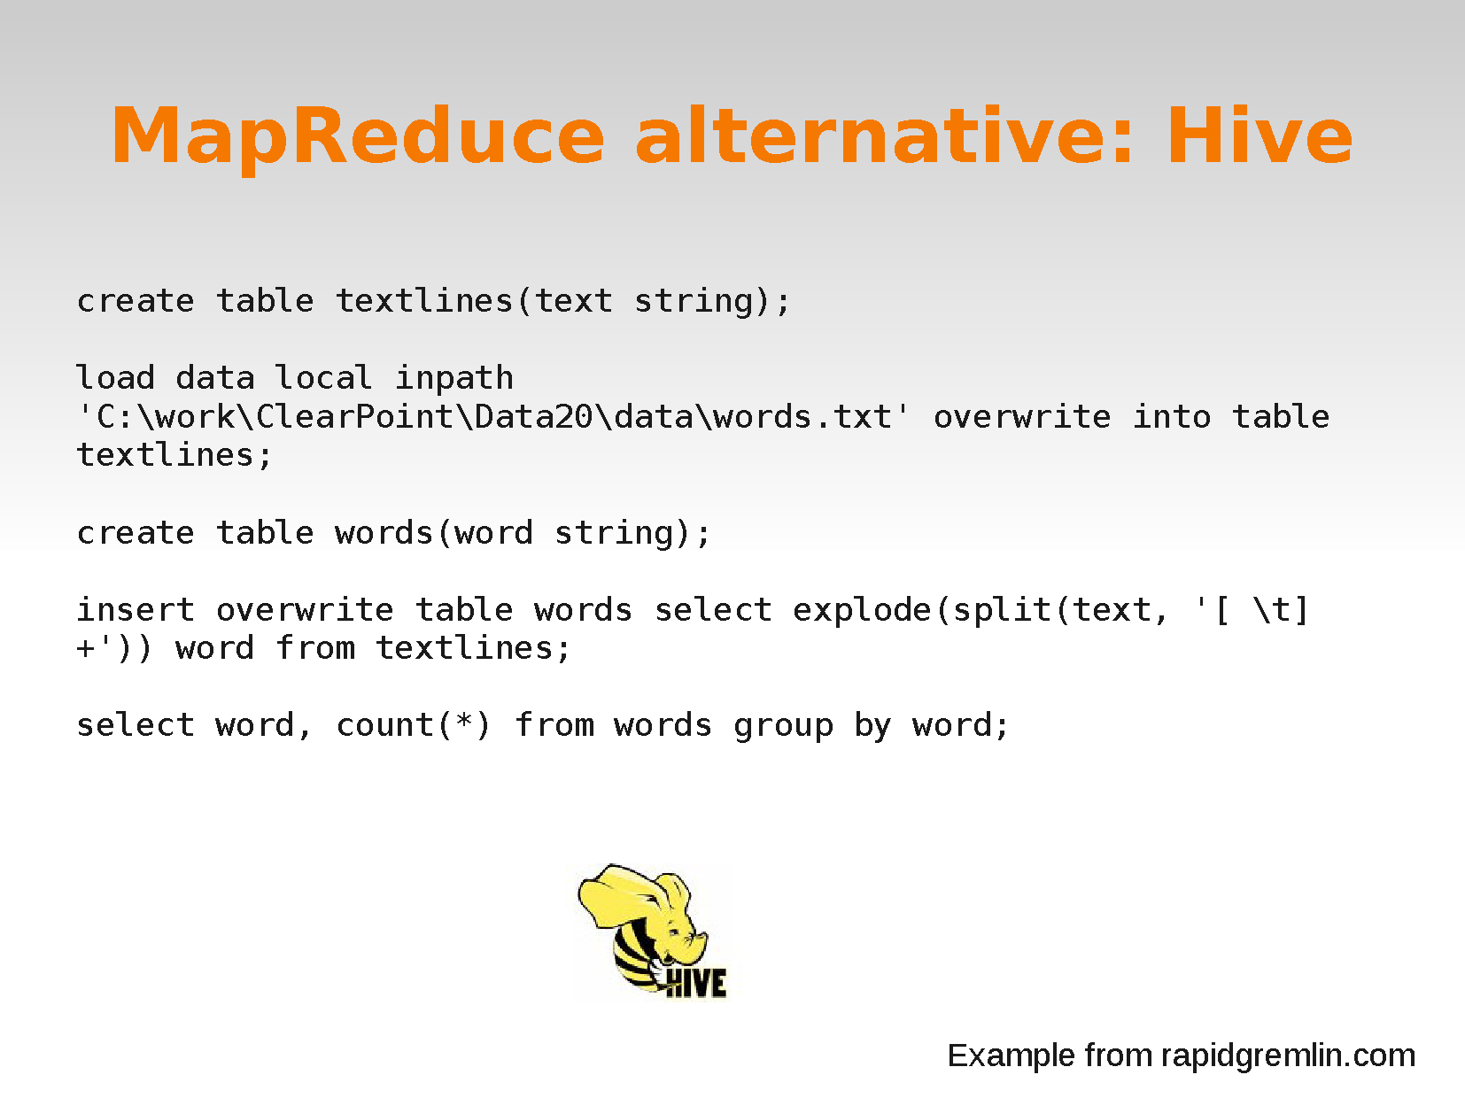

Slide 45








BIG DATA is not just HADOOP
Understand and navigate federated big data sources
Federated Discovery and Navigation
Manage & store huge volume of any data
Hadoop File System
MapReduce
Structure and control data
Data Warehousing
Manage streaming data
Stream Computing
Analyze unstructured data
Text Analytics Engine
Integrate and govern all data sources
Integration, Data Quality, Security, Lifecycle Management, MDM
Notes:
45
45
I told you big data is not equal to Hadoop. Hadoop is just its subset. There are much more areas and particular items being part of this area. Do you see the yellow elephant? This is a hadoop logo. Do you know it’s history?
---------------
Many people think big data is about Hadoop technology. It is and it isn’t. Its about a lot more than Hadoop. One of the key requirements is to understand and navigate federated sources of big data – to discover data in place. New technology has emerged that discovers, indexes, searches, and navigates diverse sources of big data. Of course big data is also about Hadoop. Hadoop is a collection of open source capabilities. Two of the most prominent ones are Hadoop File System for storing a variety of information, and mapreduce – a parallel processing engine. Data warehouses also manage big data- the volume of structured data is growing quickly. The ability to run deep analytic queries on huge volumes of structured data is a big data problem. It requires massive parallel processing data warehouses and purpose-built appliances for deep analytics. Big data isn’t just at rest – it’s also in motion. Streaming data represents an entirely different big data problem – the ability to quickly analyze and act upon data while its still moving. This new technology opens a world of possibilities – from processing volumes of data that were just not practical to store, to detecting insight and responding quickly. As much of the worlds big data is unstructured and in textual content, text analytics is a critical component to analyze and derive meaning from text. And finally, integration and governance technology – ETL, data quality, security, MDM, and lifecycle management. Integration and governance technology establishes the veracity of big data, and is critical in determining whether information is trusted.
The reason that big data is currently a hot topic is partly due to this technology – it is now possible

Slide 46
Big Data is hard….
When the operations on data are complex:
Eg. Simple counting is not a complex problem.
Modeling and reasoning with data of different kinds can get extremely complex
Good news with big-data:
Often, because of the vast amount of data, modeling techniques can get simpler (e.g., smart counting can replace complex model-based analytics)…
…as long as we deal with the scale.

Slide 47
Why Big-Data?
Key enablers for the appearance and growth of ‘Big-Data’ are:
Increase in storage capabilities
Increase in processing power
Availability of data

